Slide 1
Preparing for EPA Inspections Martin Beran Tammy White Barkalow

Slide 2
Overview
Background on EPA Inspections
Preparation for the Big Day
What Happens during the Inspection
Things to Keep in Mind

Slide 3
Background
Additional inspectors are being hired
Inspectors are writing up less significant findings
Inspection duration is variable
These inspections are considered “Neutral Scheme”

Slide 4
Because inspections are both audits of
study and facility compliance reviews
Preparation is Key

Slide 5
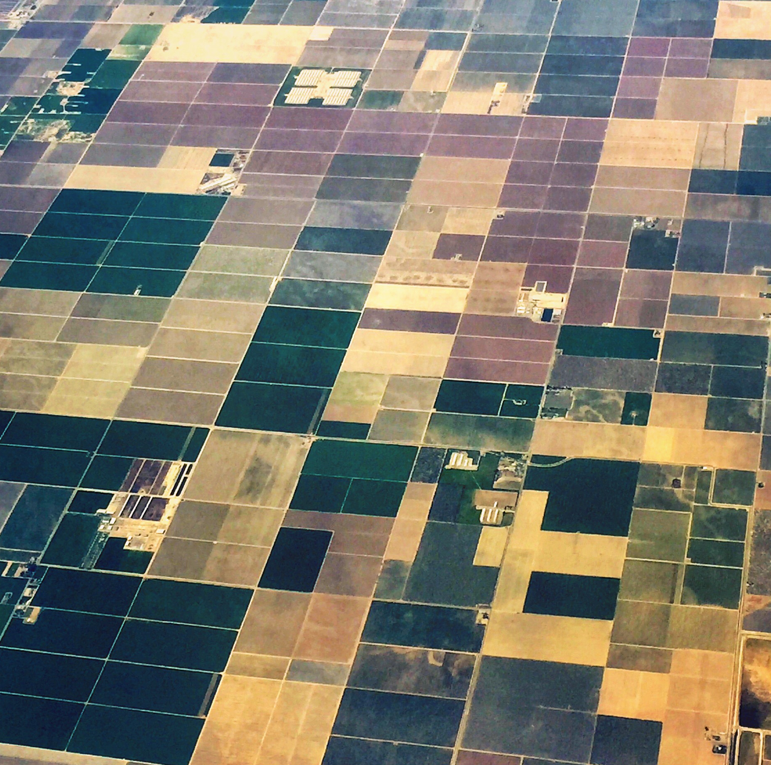
EPA Selects Your Site Based On
Last Date of Inspection
Geographic Location
Compliance History
Number of Studies Submitted
If EPA Requests the Inspection

Slide 6
Preparation Strategies
You should start preparing the moment you are notified of inspection
Set aside the day before for your Regional QA to prepare
Reacquaint yourself with the Inspected Studies
Review your Facility Documents

Slide 7
Preparation Strategies
Know your Master Schedule
Historic and Current SOPs
Review Raw Data from the Study
Application Sections
Analytical Sets
Test or Reference Substance Documents

Slide 8
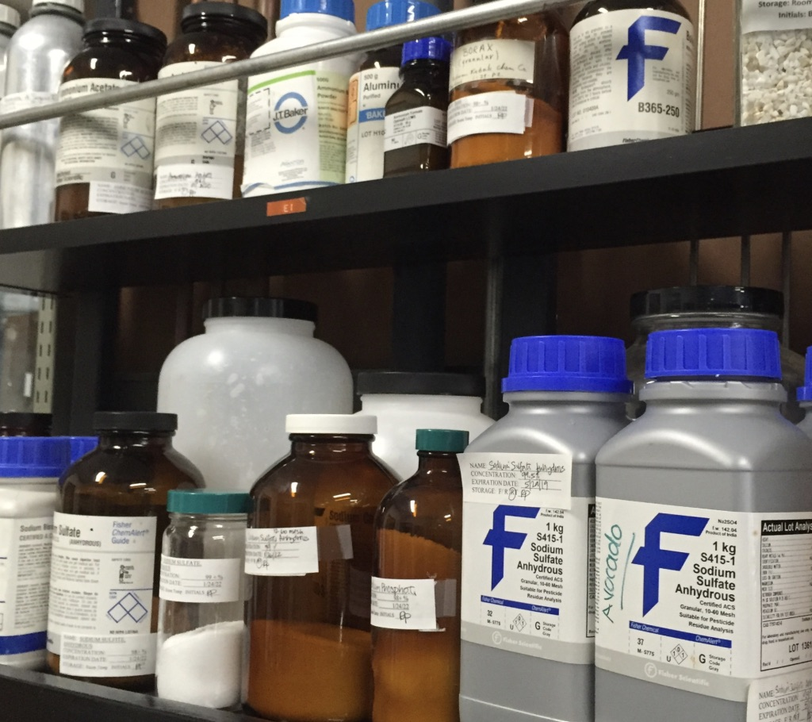
Preparation Strategies
Be aware of specific Trial or Analytical issues
Check for missing requirements on Test Substance,
Reference Substance, and Reagents.
All Personnel documents
should be up to date. Don’t
make major changes after
being notified

Slide 9
Preparation Strategies
Maps and Org Charts should reflect current layouts
Arrange for a conference room or office space where the inspector can work
Find out what time the inspector will arrive
Decide who you want at the opening conference

Slide 10
QA Preparation
Review Databooks and ASRs to ensure findings have been addressed
Arrive at the testing facility the day
before to assistant in preparation
Review materials that arrive
from HQ
Walk through of facility
and answer questions

Slide 11
Headquarters Preparation
Headquarters receives email letter notifying them that a testing site will be inspected
Headquarters sends email notification to the FRD/LRD, Regional QA, and Regional Field Coordinator
Letter identifies studies being audited, data EPA wants, and where to send it

Slide 12
Headquarters Preparation
HQ QA or Study Director arranges for test and reference substance characterization data from registrants as requested by the inspection letter
HQ will send a package containing;
HQ CVs and Org Chart
Original Databooks
Characterization Data
Final Reports/Study Records
Master Schedule
Historical Facility Records

Slide 13
The Inspection
The EPA requires an inspector to do;
Show Credentials
Provide a Notice of Inspection
Inspect at Normal Business Hours
Determine the inspector’s agenda. Find out order of activities, personnel the inspector may want to talk to, and when they want to take a facility tour
If they want to work alone, let them know how to get in touch with someone. Don’t let them wander

Slide 14
The Inspection
The inspector will look at your master schedule and pick an on-going or recently completed study to see how you are currently doing things.
Answer any questions in a concise
manner.
QA will always be present
to take notes
Keep HQ in the loop. The SD
can help answer questions

Slide 15
Closing Conference
Have all personnel present at the closing conference
The inspector will ask for copies of documents during the inspection. You will be given an inventory of what they are taking.
The inspector will bring up any findings or concerns.
Clarify any points where there may be discrepancies and provide supporting documentation
You will receive a list of observations

Slide 16
And if EPA has Findings?
Notify HQ immediately. Their answer might correct the problem
Ask if any corrective documentation or action is necessary
If so, respond in writing, including any supporting documentation to show corrective actions have been taken

Slide 17
And if EPA has Findings?
Communication of corrective actions will be done by Testing Facility Management. They along with the SD are responsible for GLP compliance
Provide time-frame when corrections will be implemented if can’t be fixed right away
Expecting the Closing Letter within six months

Slide 18
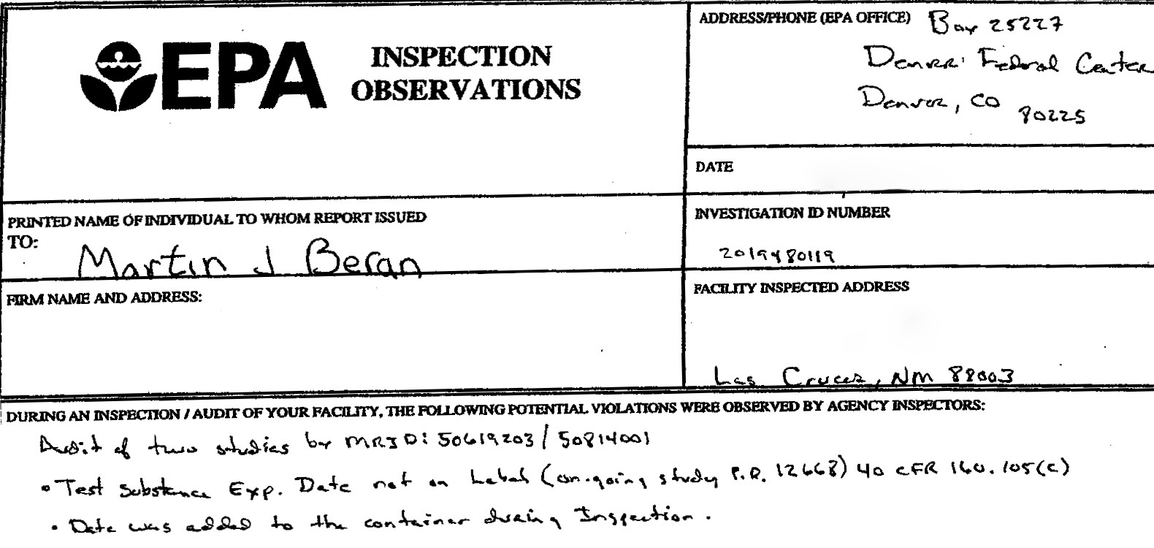

Slide 19
Be Prepared
Make sure ALL containers have proper labeling in preparation for any potential EPA inspection
File documents so easily retrievable
Update facility documents regularly
CV, training, job description
Organization chart
Facility map
SOPs

Slide 20
Be Honest
Treat Inspector with Respect
Read your SOP on EPA Inspections
Have Requested Documents Ready
Answer only those Questions asked
Rely on your QA

Slide 21
Questions

