Slide 1
QC vs. QA What’s the difference in field data book reviews?
Sherita Normington
Mika Tolson
National Education Conference
February 26, 2020

Slide 2
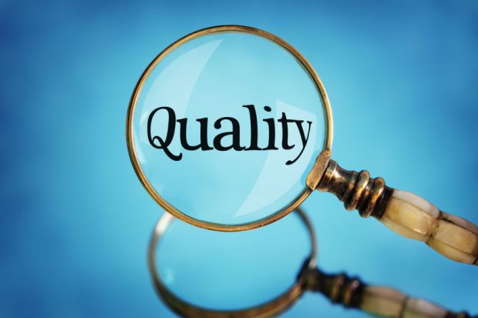
Quality Field Data Book
Adheres to the GLPs, protocol, facility standard operating procedures
Accurately reflects the conduct of the trial

Slide 3
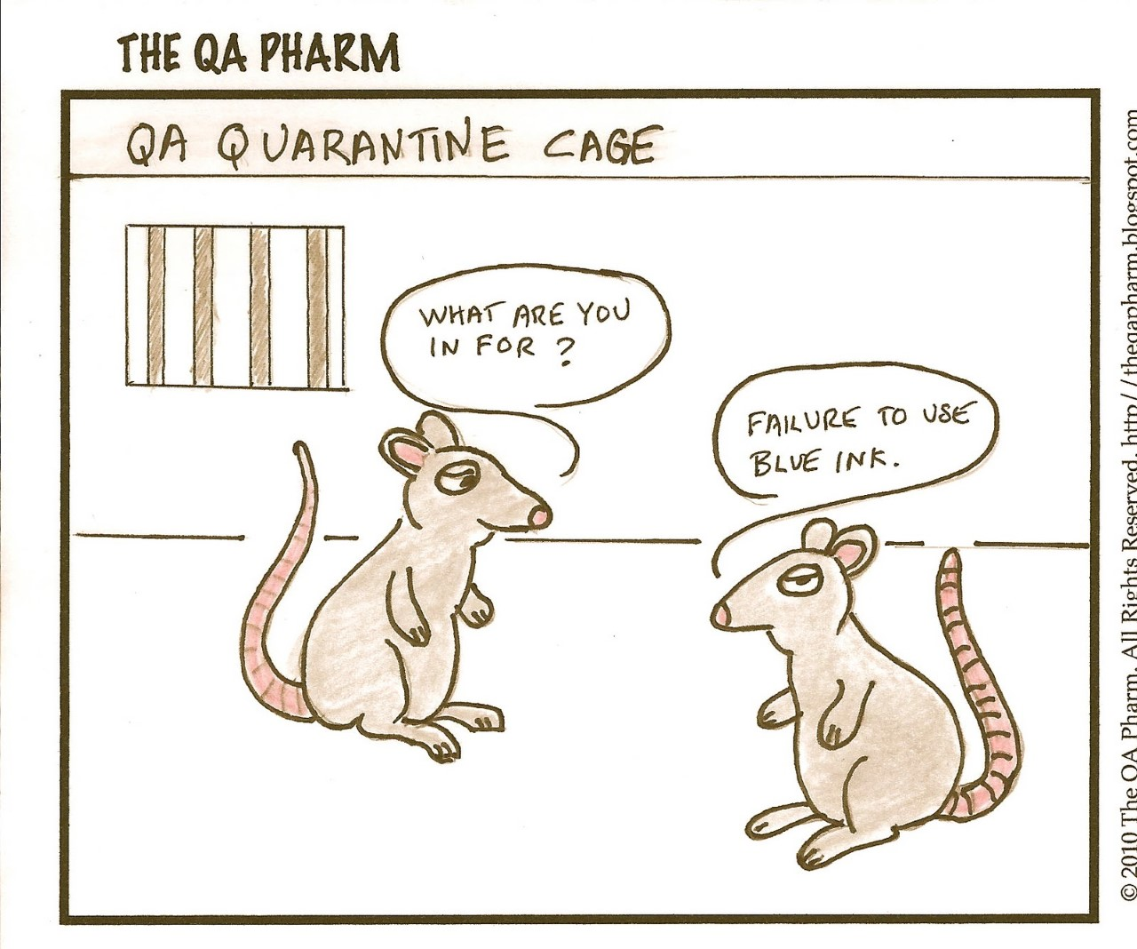

Slide 4
Complementary Roles
Quality
Control
Quality Assurance
Quality Control (QC)
Field data book meets the requirements of the GLPs, protocol and SOPs
Quality Assurance (QA)
Processes in place at field sites
Field data book meets requirements of the GLPs, protocol, and SOPs

Slide 5
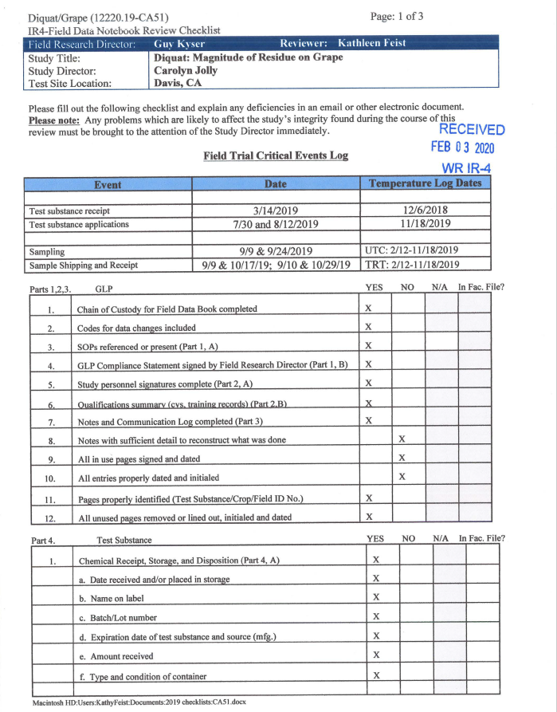
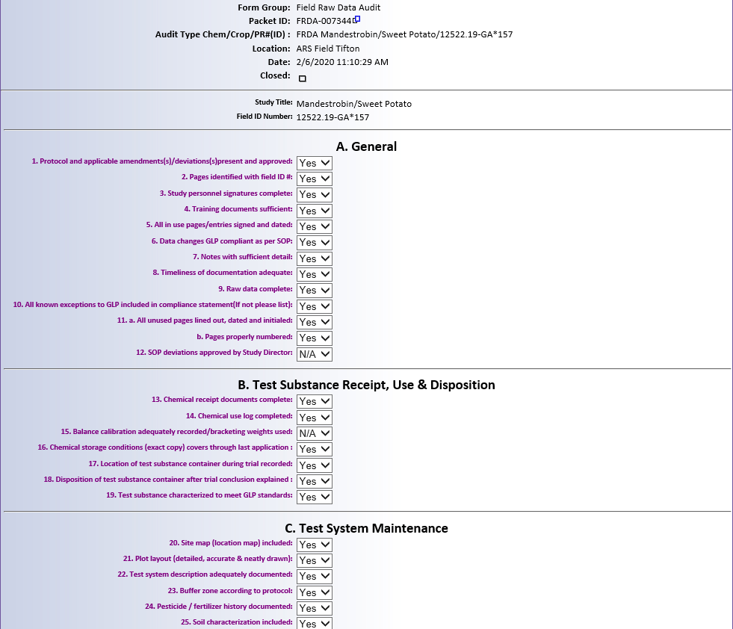
Basic review/audit process
Protocol
Checklist
Data
Protocol
Rview/Audit checklist
Data
Who and when entered
Legible
Accurate
Reconstructable
Submit report
Submit Report

Slide 6
Differences between QC and QA
Quality Control
Quality Assurance
Defined by Regional SOPs
Reacts to problems in the FDB
Pulse on how researchers are doing
Recommends changes for future
Forms for data not included in notebook pages
Other ways to clearly present data
Defined by the Good Laboratory Practice Standards (40 CFR 160.35) and SOPs
Proactive and continuous processes
Inspections assure management that facilities, equipment, personnel, methods, practices, records and controls conform with the GLPs
Critical phase (application, harvest)
Facility inspection
Raw data audits
Final report so it accurately reflects raw data

Slide 7
Differences between QC and QA
Quality Control
Quality Assurance
Part of study personnel
Inspection report part of the study records and included in field data book
Cannot participate in study
Findings/responses not part of the study record

Slide 8
Differences between QC and QA
Quality Control
Quality Assurance
Review emailed to Study Director, Regional Coordinator, and FRD
FRD responses by email
Makes changes to raw data with FRD approval
Changes are included in the FDB provided to QA
Audit reports in eQA to management, Study Director, Regional Coordinator, and FRD
Responses in eQA
Recommends corrective actions
FRD or Study Director make the corrections to the raw data or insert corrected pages into the FDB

Slide 9
Correcting pages in the FDB
Quality Control
Quality Assurance
QC reviewers correct the pages in original FDB
Following QA review, corrections must be made to the most current original page from the FDB.
Western Region includes all QC changes/additions in scanned copy on website
Northeast, Southern and North Central Regions provide changes/additions to the FRD and they are responsible for inserting pages in FDB
The FRD must attach corrected pages to eQA and mail pages to the Study Director
The corrected pages mailed to the Study Director now become “originals”

Slide 10
Similarities between QC and QA
Quality Control
Quality Assurance
Review data for completeness
Dates, initials, error codes, page numbers, unused lines crossed out
Review data for accuracy and technical conduct
Correct calculations
Application(s) meet protocol requirements
Review data for completeness
Dates, initials, error codes, page numbers, unused lines crossed out
Review data for accuracy and technical conduct that may affect integrity of the study
Correct calculations
Application(s) meet protocol requirements

Slide 11
Why do we do This?
QC review helps the Study Directors
Many errors are corrected before FDB is audited by QA
QA assures final study report accurately reflects the raw data
If FDB isn’t accurate, final report won’t be accurate
QC and QA similar review process, but they have a different role in assuring quality field data book

Slide 12
Quality
Field
Data
Book
Raw Data
Timely entries
Dates/Initials
Accurate
Complete
Compliance
GLPs
Protocol
SOPs

