Slide 1
Organizational assessment report
2016/2017
Movement of field data books Team
Team Members: Jane Forder, Becky Sisco, Nathan Leach, Rebecca Tannenbaum, Dan Heider, Mary Lee , Grace Lennon, Tom Frieberger, Dan Kunkel (chair)

Slide 2
Review of Process
Repeatedly felt that current process is good
Need to Focus on Quality ….and Training.
Looked to the IR-4 handbook as key document to support quality and training.
  Focus on GLP aspects only, other duties should be removed
  Training and support for FRDs, especially new ones.

Slide 3
IR-4 Handbook
UPDATED 03/2020
Last update was 2007

Slide 5
Regional Field Coordinator:
This person assigns field-testing sites within his/her region (or at an ARS facility), provides sample bags, protocols, notebooks, reviews Field Data Books for accuracy and completeness, and facilitates the Field Research Director conduct of a field trial.
This will include training and all other support necessary for the successful completion of trials.
Definitions…

Slide 6
Field Research Director
A person and their staff with sufficient training and experience to conduct the field trials as outlined in the protocols.
Are responsible for maintaining a GLP compliant Facility.
Conducting field trials includes all activities specified in the protocol such as maintaining a crop; applying the test substance; harvesting, storing, and shipping samples; accurately completing the Field Data Book on time; and timely, prompt responses to QA audits. The FRD, or his/her designate, also reports all deviations from the protocol or SOPs to the SD. The FRD also informs the RFC of all deviations from the protocol or SOPs.
Definitions…

Slide 7
IR-4 Required Training for new FRDs before conducting GLP research
  Basic GLP training required as soon as possible, before beginning any field trials. Follow up with a second basic GLP training after new FRD has gained some experience to help solidify understanding and GLP perspectives.
  Visit one relevant established FRD and the RFC for hands-on training and question/answer time (repeat as needed or desired).
  Regional QA personnel meets with the new FRD for the purpose of training and orienting them to the GLP procedures and expectations related to IR-4 field trials
  Make FDBs available as teaching tools and references regarding applications, crops, methodologies.
  Create a support system for answering questions and providing mentoring and guidance (FRDs, RFC, QA, others)
  Provide “quick” QC reviews on “first” notebooks to insure understanding of trial notebook and requirements.
  Training references and IR-4 orientation documents for FRD training and orientation to IR-4 are available at: http://ir4.rutgers.edu/trainingadvisories.html
  Attend training as available, such as webinars, hands on training at national and regional level.

Slide 8
Appendix 1: Guidelines for Roles & Responsibilities of IR-4 Personnel
Role of the Regional/ARS Field Coordinators (RFC)
  Provide education and training to FRD
  Facilitate conduct and reporting of field trials
Responsibilities of the RFC (under GLPs)
  Manage and direct the field work in the region.
  Make site visits for training and field support
  Provide general support and guidance as needed
  Review SOPs and provide approval
  Responsible for QC review (maybe involve designating qualified personnel). QC review includes completed checklist that summarizes review, edits and clarification of the data.
  Responsible for verifying facility data including but not limited to (equipment, temperature and maintenance records)
  Communicate/facilitate issues regarding Field Research Directors and Field Trials to Study Directors
  Facilitate and participate in pre-study discussions (i.e. protocol and other requirements)

Slide 9
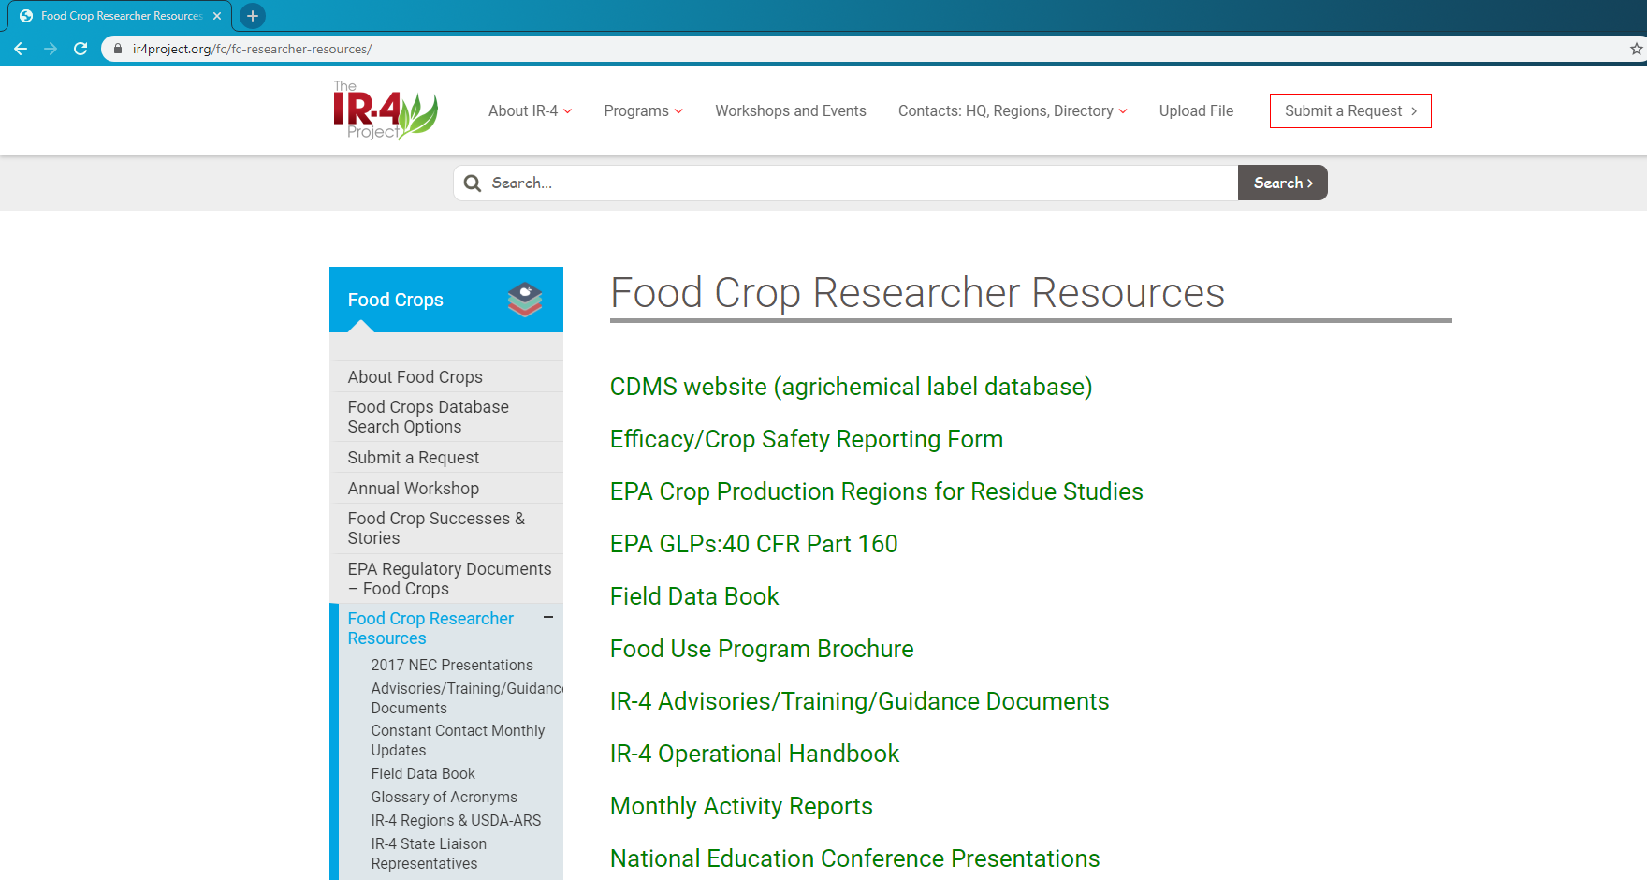
https://www.ir4project.org/fc/fc-researcher-resources/

Slide 10
