Slide 1


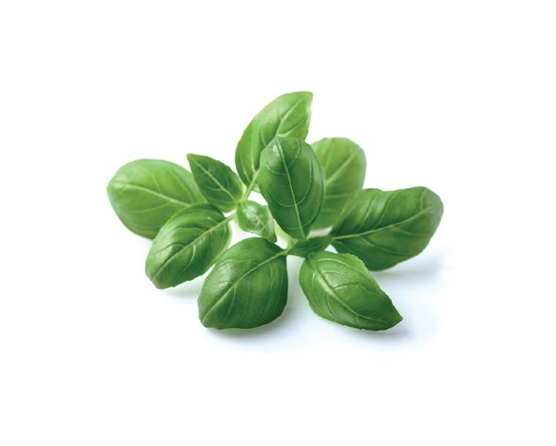
Analyzing Difficult Projects: Flupyradifurone/Basil (Greenhouse)
Bronson Hung & Fabiola G Zuno
IR-4/Trace Analytical Laboratory
Department of Environmental Toxicology
University of California, Davis

Slide 2
IR-4 Western Region Laboratory
Flupyrafidurone/Basil (Greenhouse)
(PR# 12294)
3 Treatments
TRT#01 Untreated
TRT#02 Foliar application (414mL/acre, 1X)
TRT#03 Soil drench application or chemigation (828 mL/acre, 2X)
4 Field Trials (PHI 0, 3-4, 6-7, 14 and 21 days). 3 field trials have decline on TRT #03 and 1 field trial has decline on both TRT #02 and #03
1 Crop Fraction (fresh stems & leaves). Total of 64 samples.
Validate method for 6-CNA & DFA at 0.01ppm, 0.10ppm & 1.0 ppm
in parent equivalent.

Slide 3
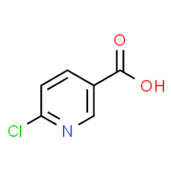
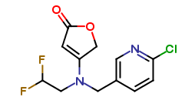
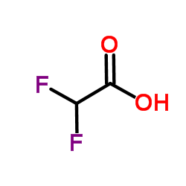
IR-4 Western Region Laboratory
Three compounds
6-Chloronicotinic acid (6-CNA)
MW: 157.6 g/mol
(Parent Equivalent Ratio ~2)
Flupyradifurone (parent)
MW: 288.7 g/mol
Fortifiy in parent equivalent
Example: 0.05ppm of DFA parent equivalent is equal to 0.017ppm of DFA
Difluoroacetic acid (DFA)
MW: 96.0 g/mol
(Parent Equivalent Ratio ~3)

Slide 4
IR-4 Western Region Laboratory
Reference Method:
Bayer Method RV-001-P10-03. An Analytical Method for the Determination of Residues of BYI02960, 6-Chloronicotinic Acid, Difluoroacetic Acid, and Difluoroethyl-amino-fluranone in Plant Matrices Using LC/MS/MS.
Validation for DFA:
0.02ppm (in parent equivalent) in matrices with high water content.
0.05ppm (in parent equivalent) in matrices with high protein, starch or oil content.

Slide 5
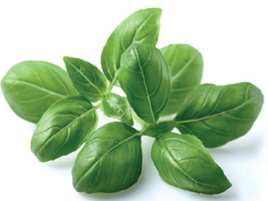
IR-4 Western Region Laboratory
Composition of basil:
The chemical composition of O. basilicum essential oil differs according to the season. These essential oils have oxygenated monoterpenes (60.7–68.9%), followed by sesquiterpene hydrocarbons (16.0–24.3%) and oxygenated sesquiterpenes (12.0–14.4%). Around 29 compounds representing 98.0–99.7% of the oil composition have been reported . Linalool was the main constituent of essential oils (56.7–60.6%), followed by epi-α-cadinol (8.6–1.4%), α-bergamotene (7.4–9.2 (3. %), γ-cadinene 3–5.4%), germacrene D (1.1–3.3%), and camphor (1.1–3.1%). In addition, components like methylchavikol, methylcinnamat, linolen, eugenol, camphor, cis-geraniol, 1,8-cineole, α-bergamotene, β-caryophyllene, germacrene D, γ-cadinene, epi-α-cadinol, and viridiflorol have been reported as important components.
Source of:
Fiber
Vitamins (beta-carotene, thiamine B1, riboflavin B2, niacin B3, pantothenic acid B5, vitamin B6, folate B9, choline, vitamin C, vitamin E and vitamin K).
Minerals (calcium, copper, magnesium, manganese, phosphorus, potassium, selenium, sodium and zinc).
M.L. Chavez-Gonzalez, R. Rodriguez-Herrera, C.N. Aguilar (2016) Essential Oils: A Natural Alternative to Combat Antibiotics Resistance . ScienceDirect ,
pages 227-237

Slide 6

IR-4 Western Region Laboratory
Extraction:
Reference Method:
Working Method:
2.0 g of frozen sample
10 mL of extraction solvent
5.0 g of frozen sample
10-25 mL of acidified 4:1 acetonitrile:water (v/v)
Geno Grinder
(1min at 1000rpm)
Blend for 1 min using a blender
Filter the sample
Centrifuge
(5mins at 4000rpm)
Extract filter cake with 10-25 mL of extraction solvent
Adjust the volume to 20 mL
Adjust the volume to 50 mL with extraction solvent

Slide 7
IR-4 Western Region Laboratory
Original plan:
Common extraction for parent and metabolites and analyze them together
Common cleanup for three compounds
Analyze three compounds together

Slide 8
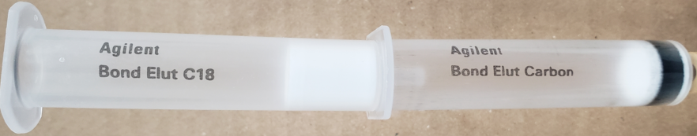
IR-4 Western Region Laboratory
Flupyradifurone cleanup:
Reference method:
Internal Standard
C18 SPE (1g/6mL)
Quantifier ion
125.9 m/z
Applied Biosystems API 4000 & 5500 Mass Spectrometer
LC-Column: SeQuant Zic-Hilic (4.6x150 mm, 5 µm packing) or Phenomenex Germini C18 (2.0x150 mm, 5 µm packing)
Working method:
No internal standard
C18 (1g/6mL) & Carbon (200 mg/6mL) .
Quantifier ion 90.1 m/z. A background in all control samples of basil was observed with the ion 125.9 m/z.
LC-Column: ZORBAX SB-C18 (2.1x50mm, 1.8 µm packing), Agilent
Agilent 6430 LC-MS/MS

Slide 9
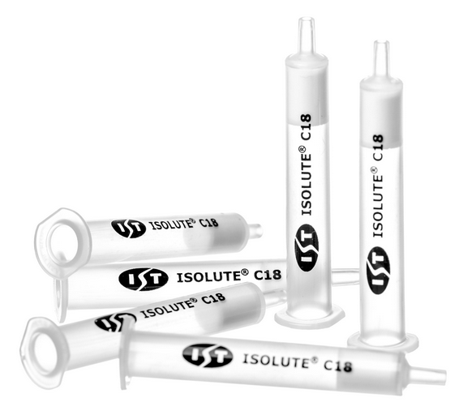
IR-4 Western Region Laboratory
6-CNA and DFA’s cleanup:
SPEs tested:
Strata-X (500mg/6 mL)
Strata- SCX (500mg/6 mL)
C18 (1g/6mL)
Carbon (200 mg/6mL)
HAX (1g/6mL)
WAX (500 mg/6mL)
SAX (2 g/12 mL)
Silica (1g/6 mL)
NH2 (500mg/6mL)
Individually and in combination
With and w/out sample
SUPPRESSION was observed for 6-CNA and DFA

Slide 10
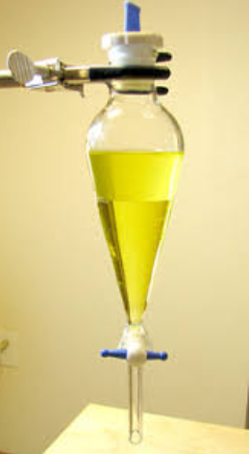
IR-4 Western Region Laboratory
Step #1:
5 mL aliquot (equivalent to 0.50 g of crop material)
Evaporation of acetonitrile at 50°C for ~18 min at 12 psi
Liquid-liquid partition with 5 mL of hexane (2X)
Organic layer with non-polar compounds
Discard layer
Aqueous layer with 6-CNA and DFA

Slide 11
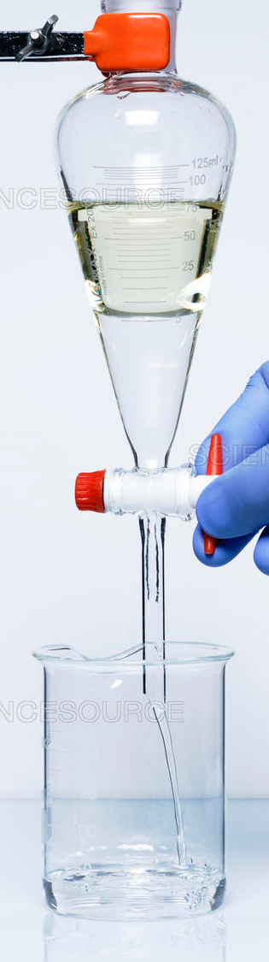


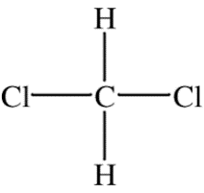
IR-4 Western Region Laboratory
Step #2:
Liquid-liquid partition with 5 mL of dichloromethane (DCM, 3X)
DFA remains in the aqueous phase across the range of tested pH values (2-9.5).
DFA
6-CNA

Slide 12
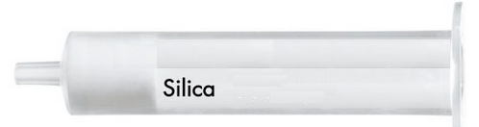
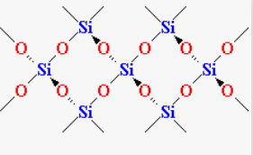
IR-4 Western Region Laboratory
6-CNA cleanup:
Evaporate the DCM to dryness
Dissolve the sample in 10mL of ethyl acetate/hexane (50/50, v/v)
Wash the SPE with one column volume (CV) of ethyl acetate/hexane (50/50, v/v) and then ethyl acetate/hexane (80/20, v/v)
Wash the SPE with 2 CVs of 100% acetone
Elute residues of 6-CNA with 9 mL of methanol/acetone (50/50, v/v)
LC-column: Phenyl-Hexyl, ZORBAX Eclipse Plus (2.1x100mm, 3.5 µm packing), Agilent
Agilent 6460 LC-MS/MS

Slide 13
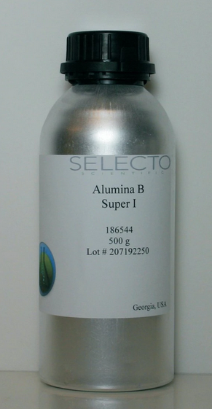
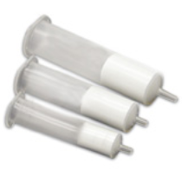
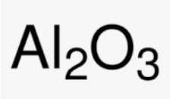
IR-4 Western Region Laboratory
DFA cleanup:
Alumina (aluminum oxide) A, B & N
Activated and deactivated
Conditioned and unconditioned
Pack column with 1-5 mL of alumina B (2 mL)
Load the sample onto the column in
acetonitrile:water (50/50, v/v)
LC-column: Phenyl-Hexyl, ZORBAX Eclipse Plus (3.0x150mm, 2.7 µm packing), Agilent
Agilent 6460 LC-MS/MS

Slide 14
IR-4 Western Region Laboratory
Compounds | Recoveries (%)
 | 0.01/0.05* ppm | 0.1ppm | 1.0ppm | 5.0ppm
Flupyradifurone | 83-106 (n=6) | 82-98 (n=4) | 93-96 (n=4) | 89-91 (n=3)
6-CNA | 74 -120 (n=6) | 74-87 (n=8) | 70-78 (n=3)
*DFA | 79-104 (n=6) | 69-106 (n=8) | 73-78 (n=3)
Sets: Validation, WI381, OH*272 & CA77

Slide 15

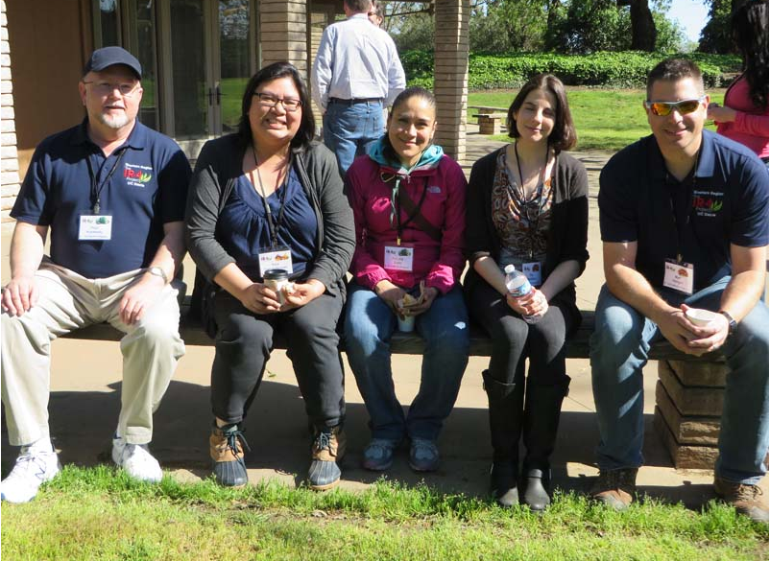


IR-4 Western Region Laboratory
Thank you

