Slide 1




How to Prepare for an EPA inspection
Fabiola G Zuno
IR-4/Trace Analytical Laboratory
Department of Environmental Toxicology
University of California, Davis

Slide 2
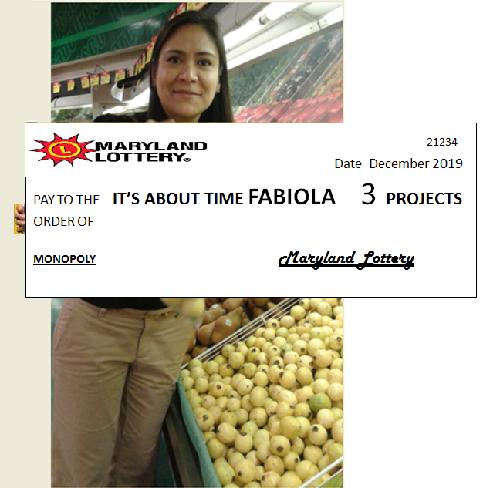
IR-4 Western Region Laboratory
EPA Audits
Lottery

Slide 3

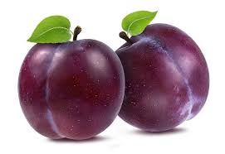
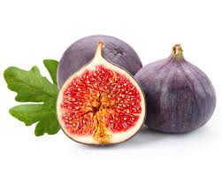
IR-4 Western Region Laboratory
Selected Projects:
Cyflumetofen/ Plum (PR# 11762)
Cyflumetofen/Cherry (PR# 11747)
Saflufenacyl/Fig (PR#11841)

Slide 4


IR-4 Western Region Laboratory
Matt Hengel (Laboratory Research
Director, LRD)
Sherita Normington & Martin Beran
(Quality Assurance)
Bronson Hung (Sample Control Officer, SCO)

Slide 5

IR-4 Western Region Laboratory
Documents:
Protocol
Amendments
Reference method
Working method
Deviations (field & laboratory)
SOPs
Raw data

Slide 6


IR-4 Western Region Laboratory
Data:
Hard copy and electronic files

Slide 7

IR-4 Western Region Laboratory
Hard copy:
Data summaries (from validation to the last set of samples).
Footnotes (recoveries out of range, issues with reproducibility between injections, contamination in control samples, issues during analysis of samples and correlation coefficient).
Preparation of stock, fortification and calibration solutions (forms and CoA)

Slide 8

IR-4 Western Region Laboratory
Hard copy:
Analysis sheets for every single set of samples
Notes related to issues occurring during sample preparation.

Slide 9
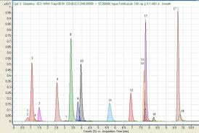
IR-4 Western Region Laboratory
Electronic files:
For every set of samples, I looked for the following files:
Worklist
Batch
Chromatograms
Tune file

Slide 10

IR-4 Western Region Laboratory
Practice:
LRD & SCO

Slide 11


IR-4 Western Region Laboratory
Inspection:
Inspector: Mark Lehr and Will Wimbish
Date:12/12/2019
Time: 9:00am to 11:00am

Slide 12

IR-4 Western Region Laboratory
Questions
How do you start working on a project after it has been assigned to you?
What are matrix effects?
What are a set of samples?
Explain sample preparation to sample analysis
With respect to sample preparation, what is the difference between the reference method and the working method?
How was the gradient program created?
Why is the diverter valve on the LC-MS/MS set up the way that is specified in the working method?
How do you create a worklist?
What is a correlation coefficient?
What is a tuning file?

Slide 13
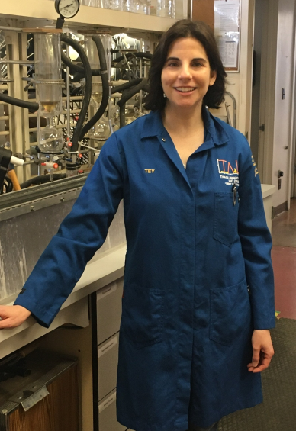
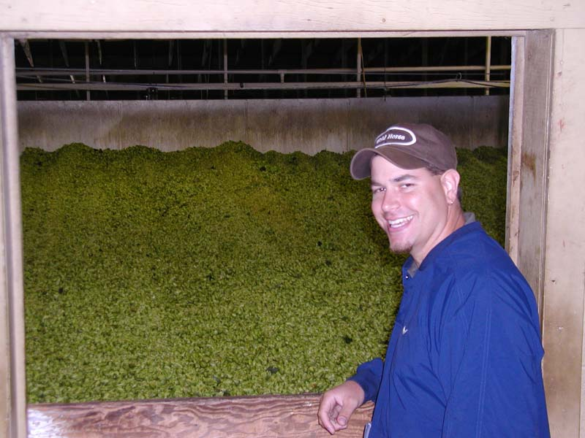



IR-4 Western Region Laboratory
Thank you

