Slide 1
Issues in Data Quality
IR-4 Headquarters
Rutgers,
The State University of New Jersey
500 College Road East, Suite 201 W
Princeton, NJ 08540
732.932.9575
fax 609.514.2612
www.ir4.rutgers.edu
Debbie Carpenter, Ph.D.

Slide 2
Data Quality
Why do I care?
Why do you care?
Does it matter?
Should I care?
Notes:
’m leaving, most of the HQ folks will be finding other jobs. Why do we continue to ask for your best work?
Many of you do care. I can see it in the quality of work on many of are projects.
If the answer is no, we can go to lunch now, and be done!
Should you care? How do you view yourselves, are you professionals. Is what you do important? Are you a pair of hands and as long as we can check the box, it is done?

Slide 3
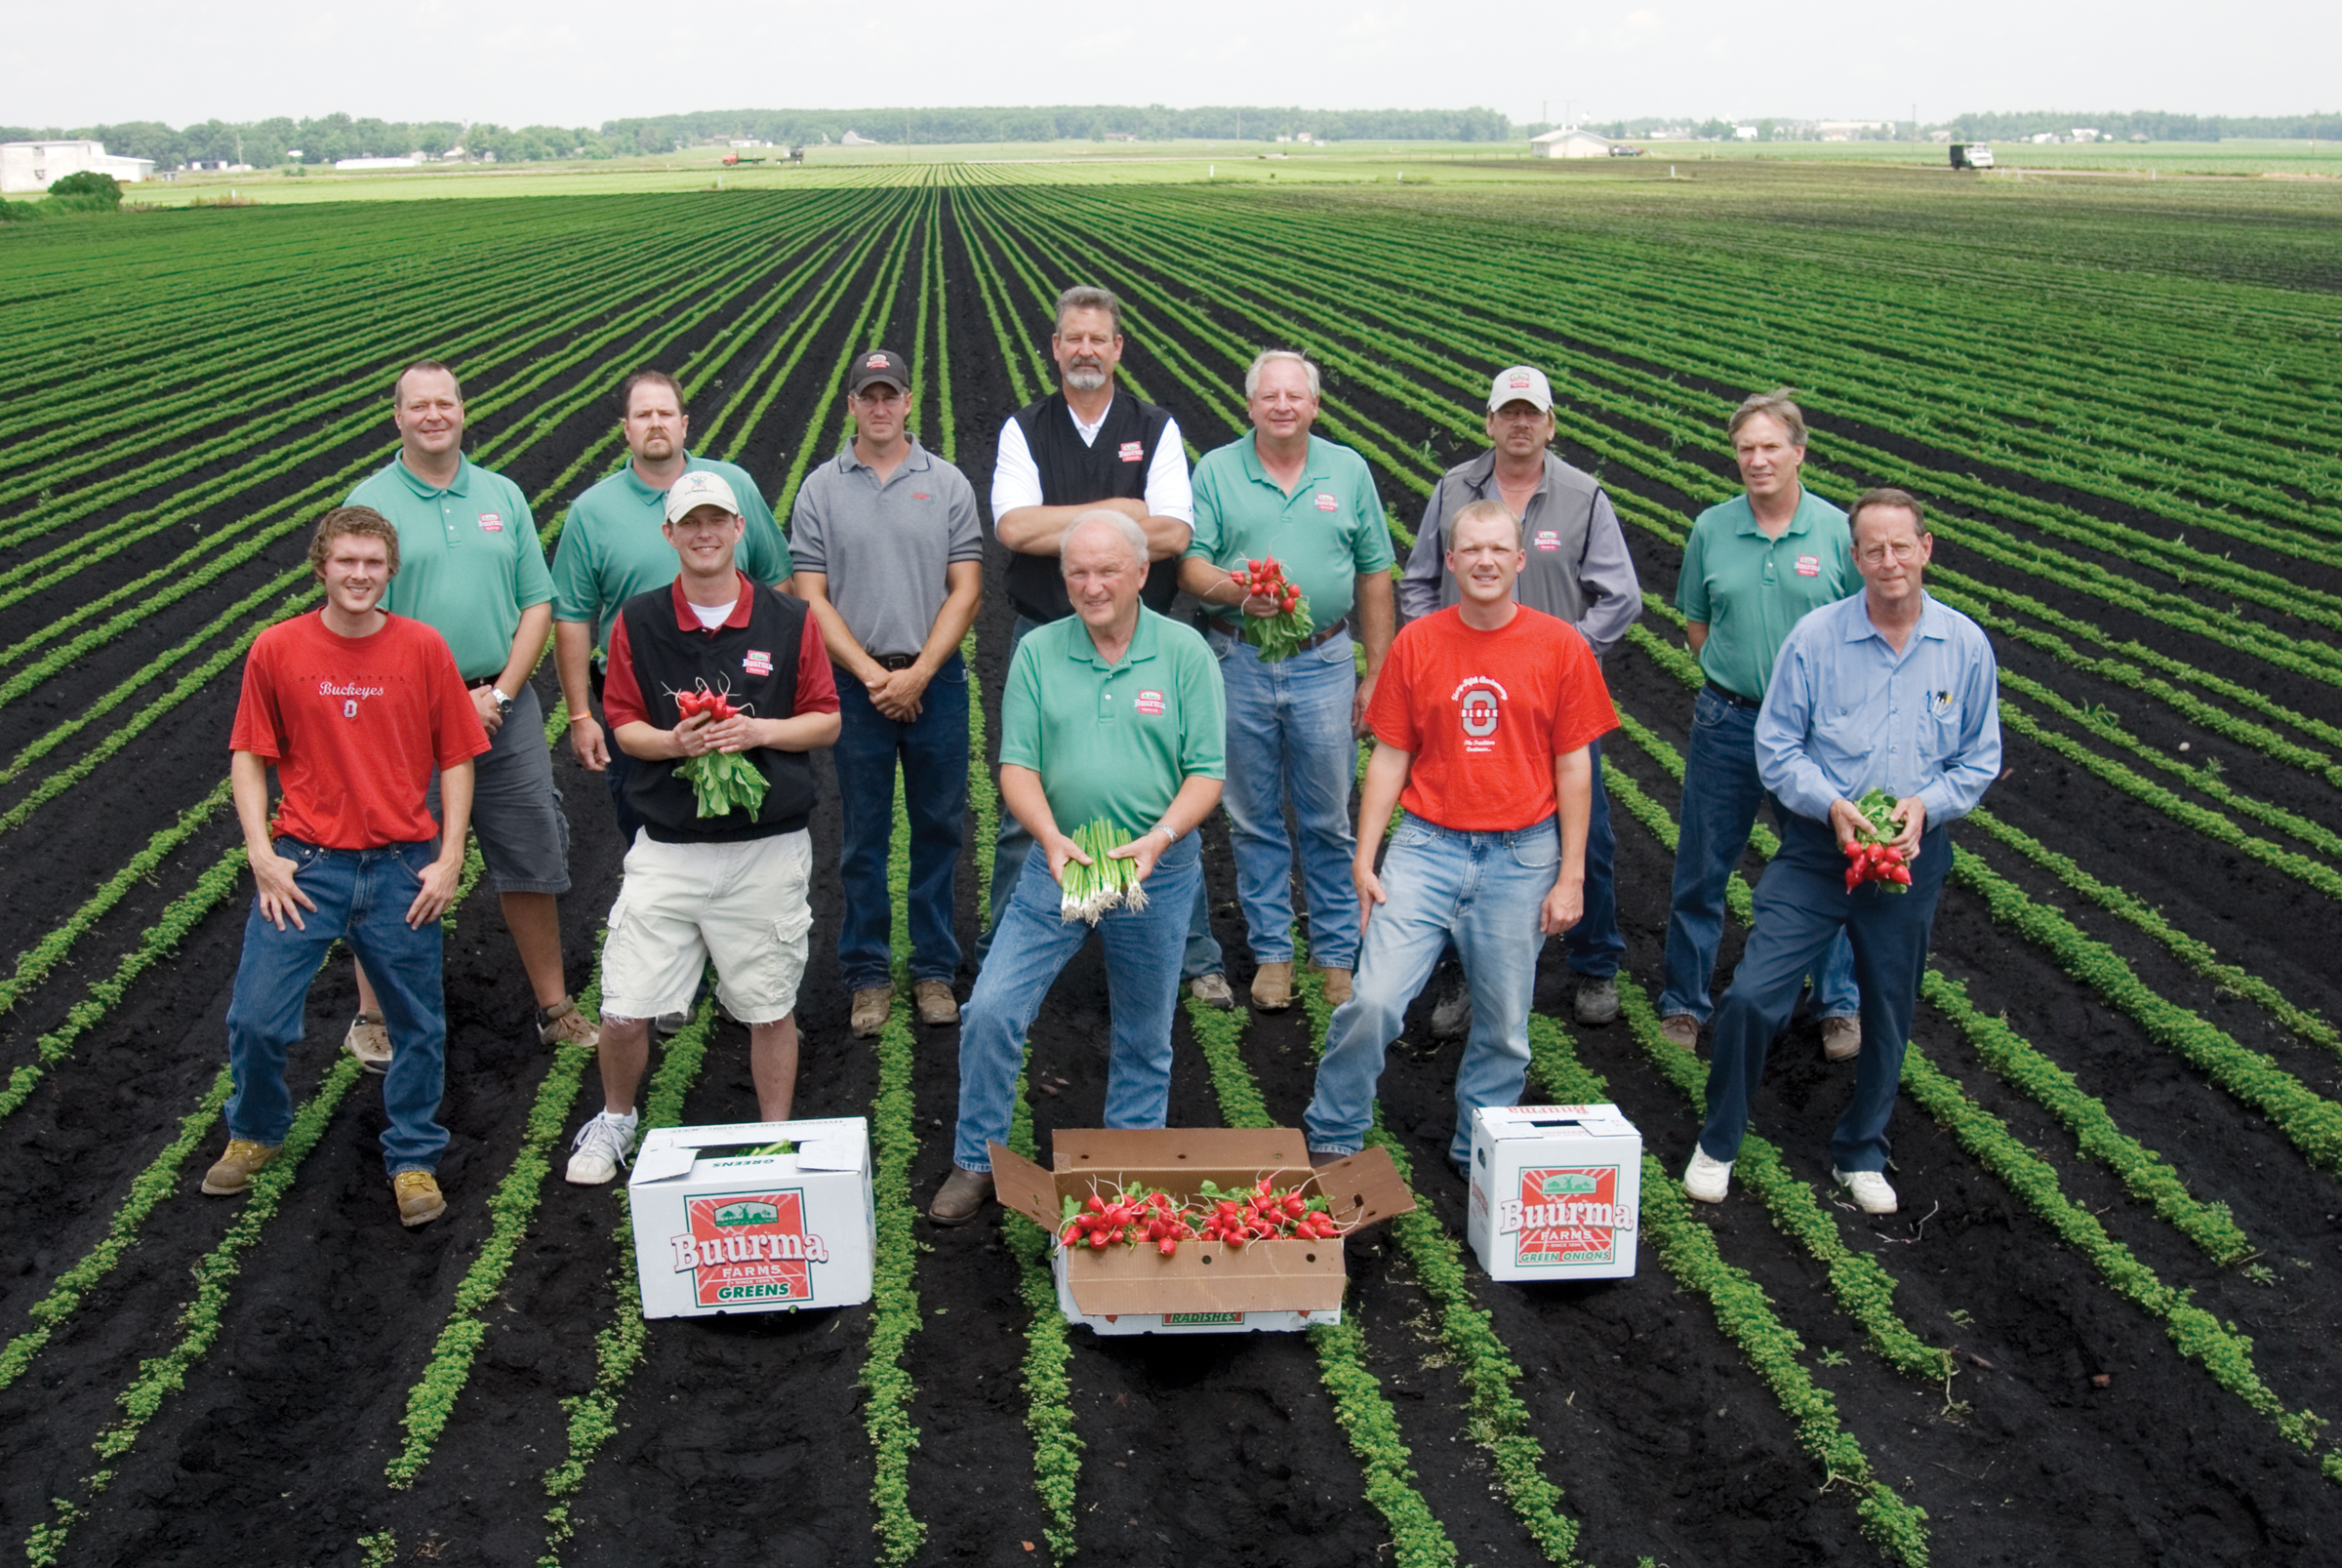

Slide 4
Commodity Liaison Committee Process

Slide 5
Regulatory Reviewers
Notes:
I have so much to do. Here is another set of data – I hope it is well written and easy to follow – and that the data looks good!
OK Method validation – regs say 70-120% and it is in that range at all levels, and the distribution is tight…yeah, so far so good. Running around 80% at the LLMV
On to the residue data…mmm…concurrent recoveries are going down…80%, 70%, and here is one with all fortifications at 60% why, what’s happening….why was the data acceptable when validation showed that recoveries could be in the eightires.
Let me check the text….I don’t see any discussion….no discussion about why these data are acceptable even though there is one set with a 60% rrecoverie at all levels.. Is this method OK to use? Can I depend on the residue values to be real, or are they higher. I don’t know, I really don’t know, but I have to make a decision on whether to use this data……

Slide 6
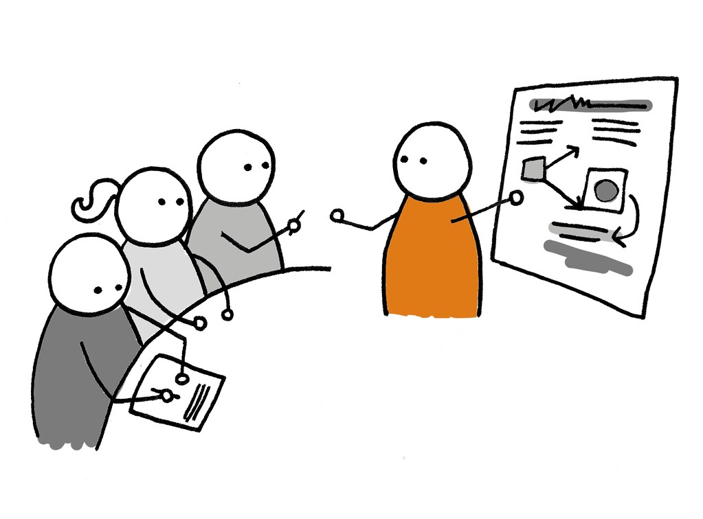
What to Do?
Notes:
Many thanks to all, but for those who need a refresher.

Slide 7
Data Quality
Quality in the laboratory should prevent mistakes by means of:
QA measures
QC of results
Thorough documentation
Efficient maintenance of records
Routine audits
Notes:
QC of each set by means of reagent blanks, replicates, verified standard solutions, etc.

Slide 8
Data Quality – Common Issues
Method robustness
Sequence structure
Manual integrations
Stability

Slide 9
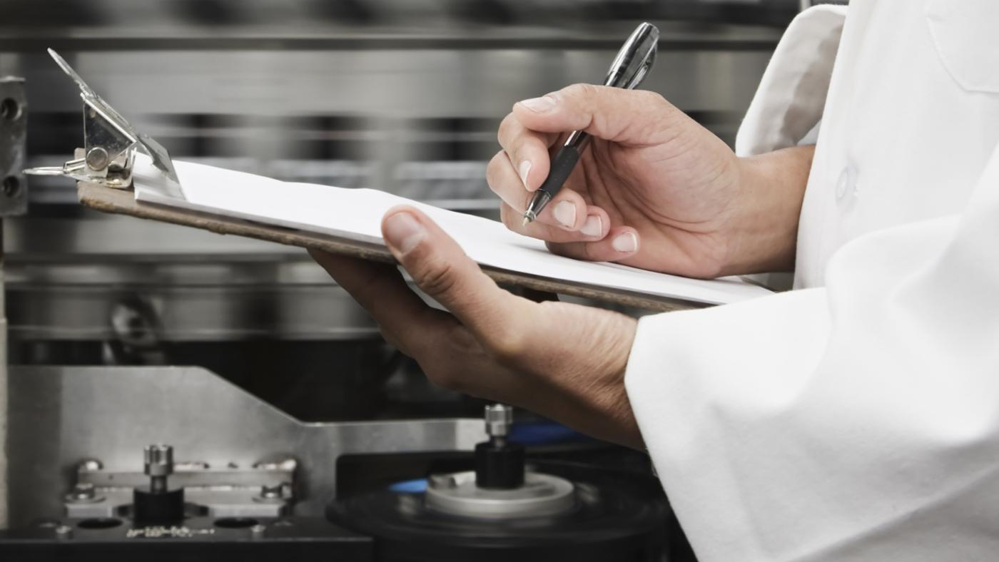
Data Quality – Common Issues
Re-extraction
Data evaluation
Documentation

Slide 10
Data Quality – Method Robustness
Check matrix effects during validation.
View UTC for obvious differences.
On the edge – any options to improve during validation?
Notes:
Comparing peak areas of calibration standards prepared in solvent vs. calibration standards prepared in matrix during validation will lessen the possible need for further method development during sample analysis
Are some controls a different color, a deeper color? Are some drier than others, Some light and fluffy? Some have more oil than others – such as sunflower?
On the edge – the goal isn’t to just make it…but rather to have amethod that will work throughout the analysis. In a perfect world….no, it only has to be good enough, but it should be good enough that you don’t have to start over at method validation.

Slide 11
Data Quality – Sequences
Consider placement of unknowns, fortifications and calibration standards.
Two calibration standards at beginning and end of sequence.
Calibration standards interspersed.
Check for drift during the run.
Notes:
What are you trying to do – beyond just get it done, to – I’m building a case that the method is working well.
Why multiple will depend on the length of the run…but you don’t want to lose the run because you don’t have a calibration std, and we shouldn’t accept runs with no calibration at the end because of a misinjection.

Slide 12
Data Quality – Manual Integration
A last resort!
Must have a consistent approach throughout the sequence.
Printout of chromatogram before and after manual integration, initialed and dated.
Notes:
Why is it a last resort? Dial a peak….get the answer you want….makes it much harder to stand behind your data. If peak integration is not possible after evaluating data with instrument parameters due to interfering peaks or other analytical reasons, manual integration may be used.
Must have a consistent approach, throughout the sequence. No dialing in the value you want.

Slide 13
Data Quality – Manual Integration
Electronic file must contain the chromatogram before manual integration.
Must have the ability to explain to an auditor how it was reprocessed and why.
Must acknowledge manual integration.
Notes:
Have to be able to show that the initial file was not being integrated well by the instrument.
An EPA auditor will ask why you used manual integration.
Must acknowledge it in the ASR and describe why. This is serious – if the data is presented as instrument integration, and someone looks closely and sees that the integration windows have changed…..does the final report reflect the raw data, or does it appear that we are trying to cover up something. Maybe the intent was good, but it looks bad.

Slide 14
Data Quality – Extract Stability
Determine if samples aren’t analyzed within 24 hours of extraction.
Store extracts as method requires or produce stability data.
Protocol allows storage for 14 days but you must have concurrent recoveries to support length of time stored.
Notes:
If you store the smaples on the benchtop, and the method says to store under refrigeration, you need to produce stability data to show the extracts are viable. More work and not something you want to do. Recommend storing in refrigerator if not stipulated.
Why does it matter – because we have to be able to defend what we did – that we didn’t lose residues by the way the samples were stored.

Slide 15
Data Quality – Re-Extraction
If something looks odd – what do you do?
Contact the SD before re-extraction.
If re-analysis is needed, reanalyze in duplicate or triplicate to confirm result.
Notes:
Duplicate injections are governed by SOPS usually.

Slide 16
Data Quality – Data Evaluation
Evaluate data immediately after run is completed – initial and date.
Check for successful run – fortifications acceptable, r-squared value, beginning and end with calibration standard.
Are the concurrent fortifications in line with the validation data.
Notes:
Duplicate injections are governed by SOPS usually.

Slide 17
Data Quality – Data Evaluation
Goal – to check off that this run is done?
Goal - data that we can defend, or recognize immediately that samples have to be rerun.
Notes:
To check off ifi tit done? What you do is important, we must be able to defend it. If that is your only goal, it is done, I ask you to consider something more than that because
Someone will have to defend your data.

Slide 18
Data Quality – Data Evaluation
Contact the study director if samples must be rerun.
Ability to rerun samples immediately.
Hard to defend at the end of the study, if samples should have been rerun, and weren’t.
Notes:
Themes here – contact the study director when needed
Data must be defendable

Slide 19
Data Quality – Documentation
If it isn’t documented, it wasn’t done.
Ensures traceability.
Reminds you of next steps.
Who (initials), what, when (date), where and why entered promptly in the data file.
Notes:
Themes here – contact the study director when needed
Data must be defendable

Slide 20
Data Quality – Expectations
Data must be defendable.
Empowered labs – look at data critically.
Well trained in GLP regs /other guidelines.
Constant recognition of our customers.
Accountable for your job performance.
Notes:
If you remember nothing else from today, remember that someone, somewhere in IR-4 will have to defend your data.

Slide 21
Data Quality – Expectations
Do my expectations matter?
Notes:
’m leaving, most of the HQ folks will be finding other jobs. Why do we continue to ask for your best work?
Many of you do care. I can see it in the quality of work on many of are projects.
If the answer is no, we can go to lunch now, and be done!
Should you care? How do you view yourselves, are you professionals. Is what you do important? Are you a pair of hands and as long as we can check the box, it is done?

Slide 22
Data Quality – Attitude
I look at my data critically.
I am well trained.
I know the GLP regulations and other guidelines and I follow them.
I know my customer’s needs.
I do my job well. My data packages show I am proud of what I do!
Notes:
I look at my data critically – I know that I can defend what I have done. If someone asks me, I’m sure I can reconstruct the study. For those who supervise, does everyone in your lab do this?. I ldocument why the data is good. I let the study director know if there are issues.
I follow GLP 0 and a plea – if you think the GLP regulations are silly or a problem, please do everyone, your colleagues and the program a favor – don’t create a toxi environment, but move on – because this is the framework in which we must operate.
I care about my customers – about th epeople who have to look at what I do, I know what they expect, and I put my data in the format that is needed
I am not just a pair of hands and my work reflects that.
Many thanks to those of you who do this every day, that this is your attidude when you come to work.

Slide 23
Data Quality
What we do matters.
Will you do your very best each day?
Notes:
What we do matters – to our stakeholders, to our reputation, to the farmers who grow our food.To the integrity of IR-4
Will you do your best every day, crticiallly looking at your own data, and deciding whether it is acceptable.

Slide 24
IR-4 Teamwork Produces Results
IR-4 is successful due to dedicated field and lab researchers who generate solid data and provide research documentation sufficient to reconstruct the study.
THANKS FOR ALL YOUR HARD WORK!!
Notes:
Western Region FRDs:
Switch/caneberry – Ron Wight
Thia/carrot – R. Wight, B. Boutwell, R. Lee, S. Benzen, M. Miller
BAS500/cole crops – S. McDonald/C. Oman, S. Benzen, R. Lee, B. Boutwell, C. Cornwell, M. Miller, M. Straugh
Examples of the importance of IR-4 work:
- Switch saved PNW caneberry growers!
- BAS500 saved endive production for CA Vegetable Specialties in Rio Vista, CA
- Fludioxonil/pomegranite (ph) has doubled marketable fruit coming out of post-harvest storage
- Fludioxonil/stone fruit (ph) – the day it was labeled, the registrant sold half a million $ of Scholar

