Slide 1
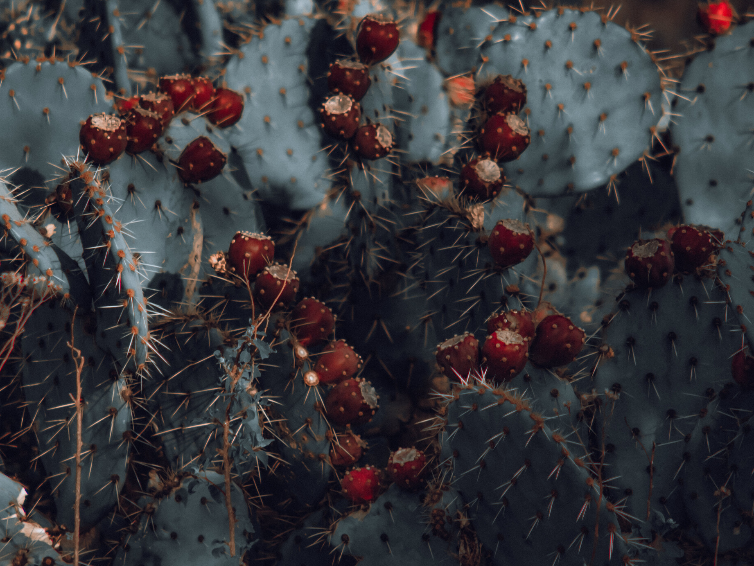
IR-4 NORTH CENTRAL REGION LABORATORY
Method Development for Flonicamid on Prickly Pear
Lester Geissel, Sima Kumar

Slide 2
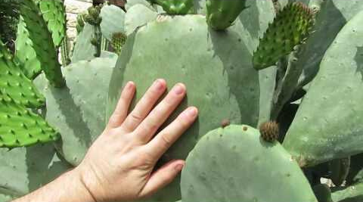
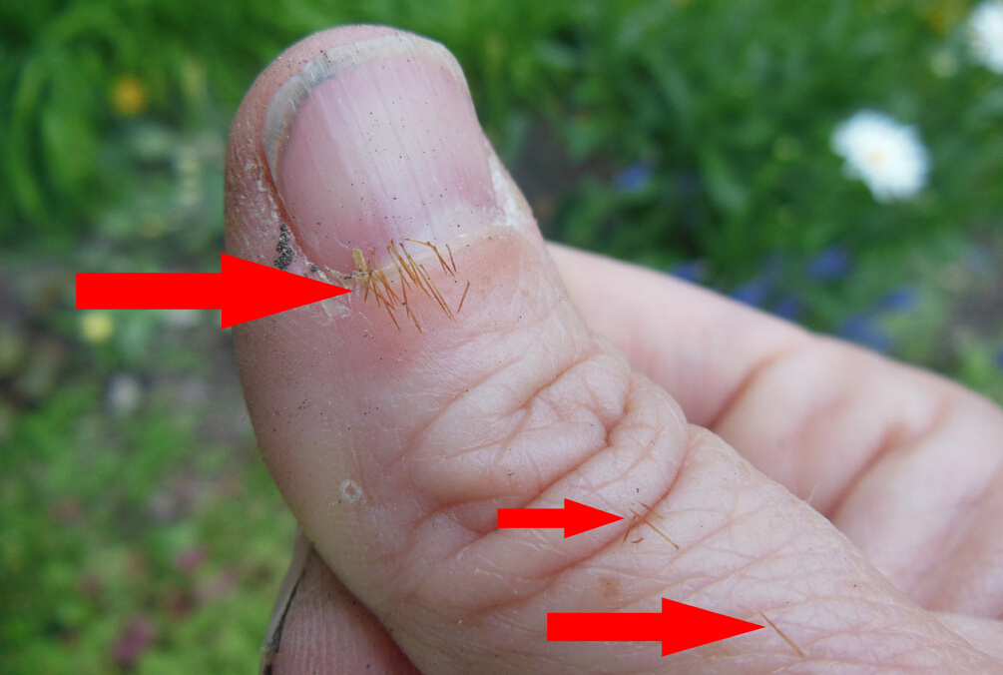

Slide 3
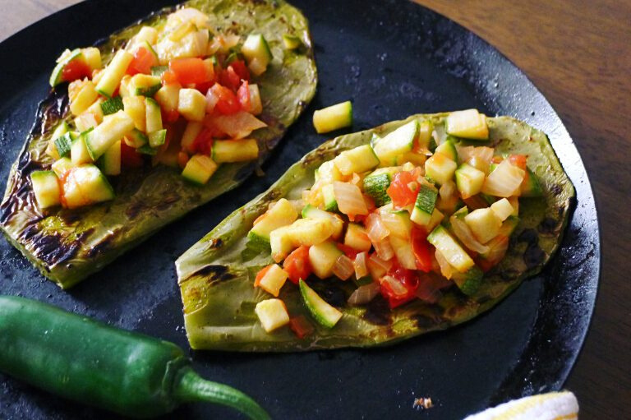

Slide 4
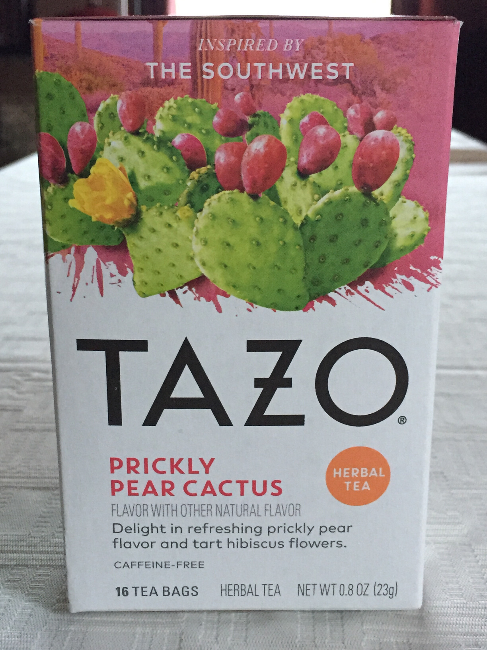
Ingredients:
Hibiscus Flower
(reduce blood pressure)
Chamomile Flower
(reduce anxiety)
Orange Peel
Natural Flavor
Sunflower Lecithin
Soy Lecithin

Slide 5
THE PROBLEM
SOLUTIONS ATTEMPTED
RESULTS OF ATTEMPTS

Slide 6
FLONICAMID AND THREE METABOLITES
TFNA
TFNG
TFNA-AM
FOLLOWED REFERENCE METHOD
- Two cleanup steps: C18 SPE column, and ethyl acetate partition
- First control showed significant interference or contamination for: TFNA and TFNA-AM
Method Development

Slide 7
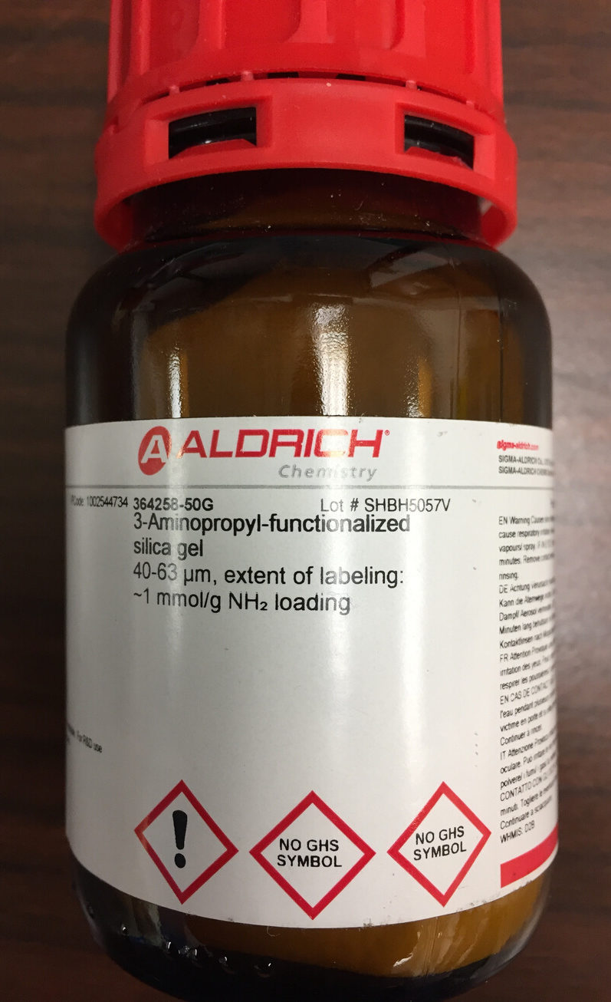
PSA (3-AMINOPROPYL FUNCTIONALIZED SILICA GEL) CLEAN UP AT
0.2G AND 0.4G
No improvement
SOLVENT BLANK THROUGH REFERENCE METHOD
Came up clean
TRIAL CONTROL WITH GLASSWARE FROM SOLVENT BLANK TEST
Steps
Peaks still present

Slide 8
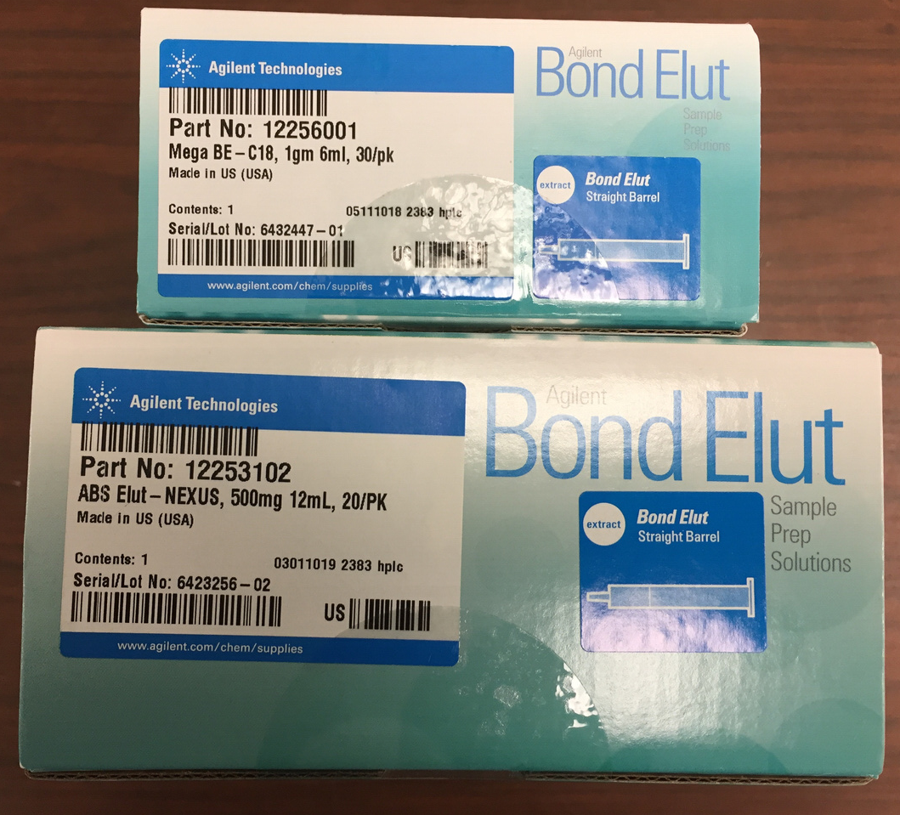
TRIED CONTROL FROM INITIAL TRIAL AND ONE FROM EACH REMAINING TRIAL
All peaks still present
CONTACTED CA LAB - THEY SENT THEIR FLONICAMID ON HOPS
Had the C18 and ethyl acetate clean up, plus additional Nexus SPE clean up column
Peaks still present
Steps

Slide 9
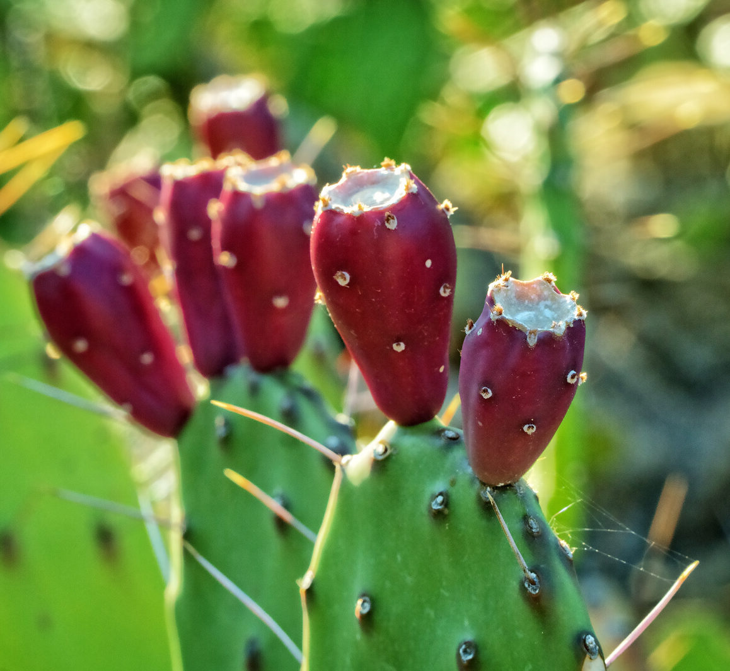
HORROCK'S FARM MARKET
They sold prickly pear pads - some were purchased for test run
RAN HORROCK'S PRICKLY PEAR PADS
Results were good - no peaks
Steps

Slide 10
Recovery Issues
- Spiked blank solutions at various points
- Loss occurring during evaporation steps
- N-EVAP was taking a long time for evaporation of:
- Acetonitrile:water after C18 column
- Ethyl acetate from the partition

Slide 11
Recovery Issues
Tried:
- increasing bore size of N-EVAP needles
- increasing water bath from 45C to 50C
Result:
- This combo slightly improved recoveries
Increased recovery with 1ml of water added before evap of ethyl acetate
Also collected fourth ethyl acetate partition and found small amount of analytes (added fourth partition to working outline)

Slide 12
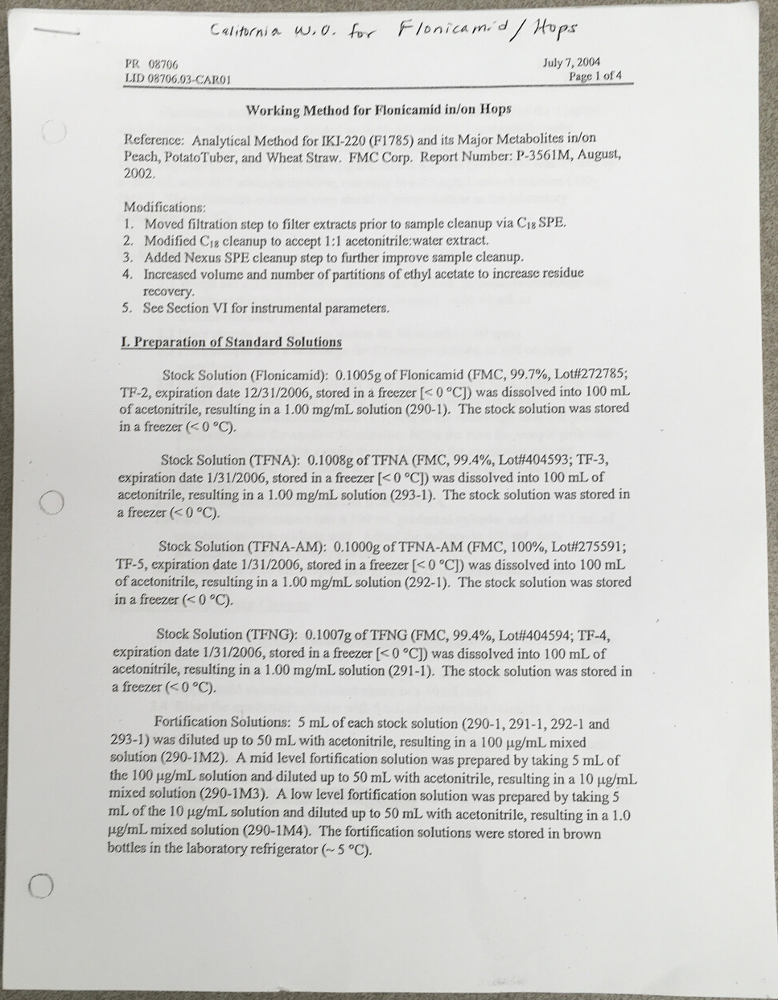
CA Working Outline mentioned Turbovap
Using the Turbovap, we tried:
- addition of 0.5ml of water to the ethyl acetate
- water bath temp set at 50C
Result:
- Evaporation rate increased
- Recovery in acceptable range

Slide 13
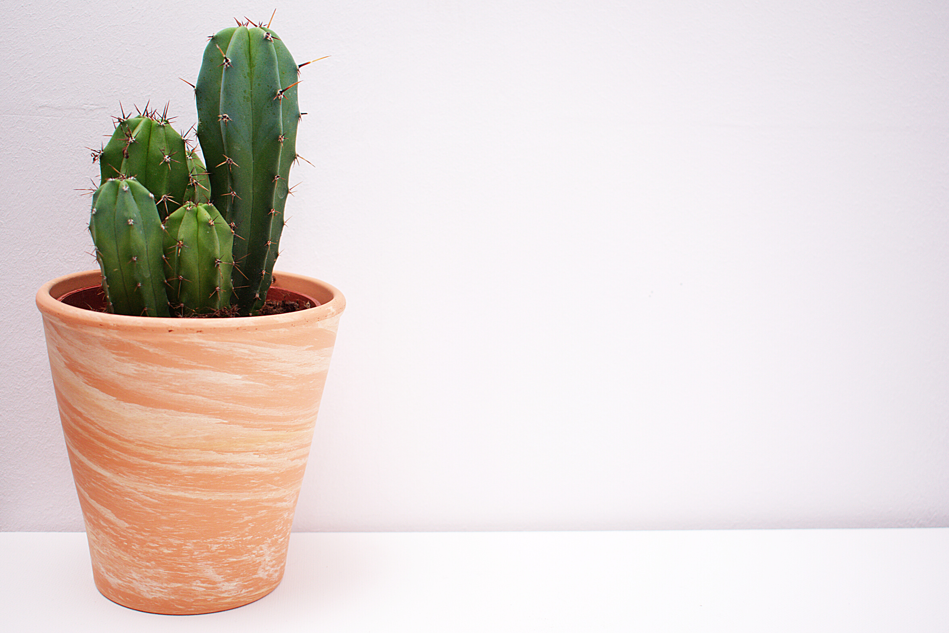
Prickly
Beyond
Com-pear

Slide 14
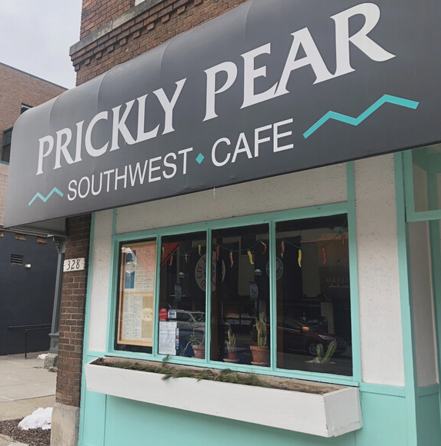
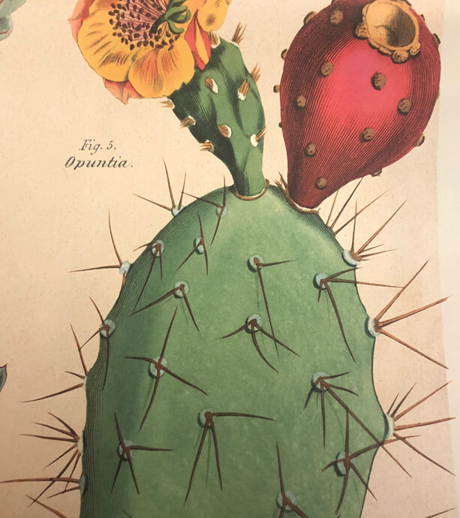
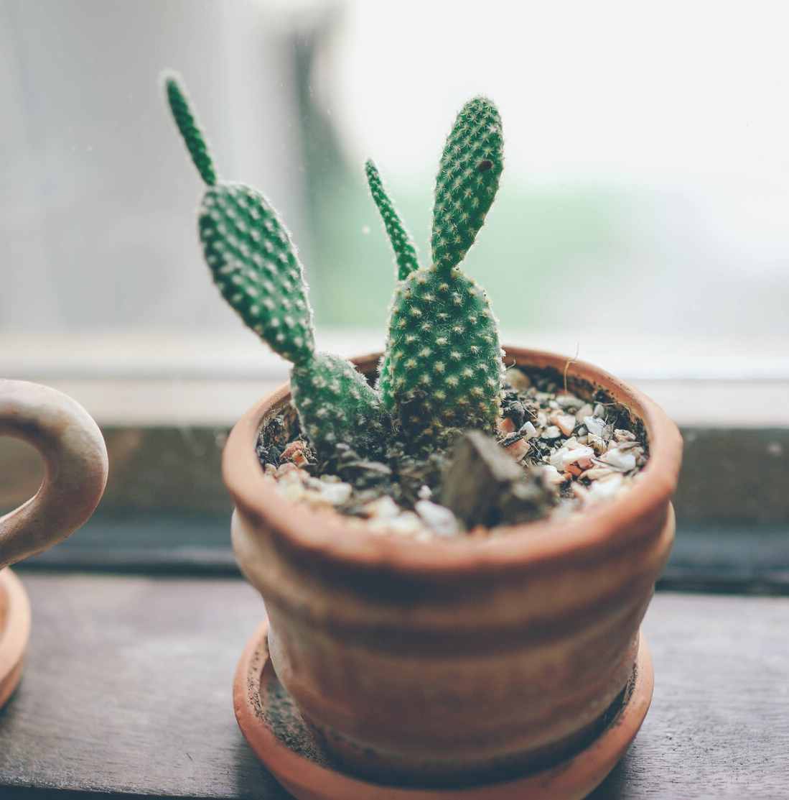
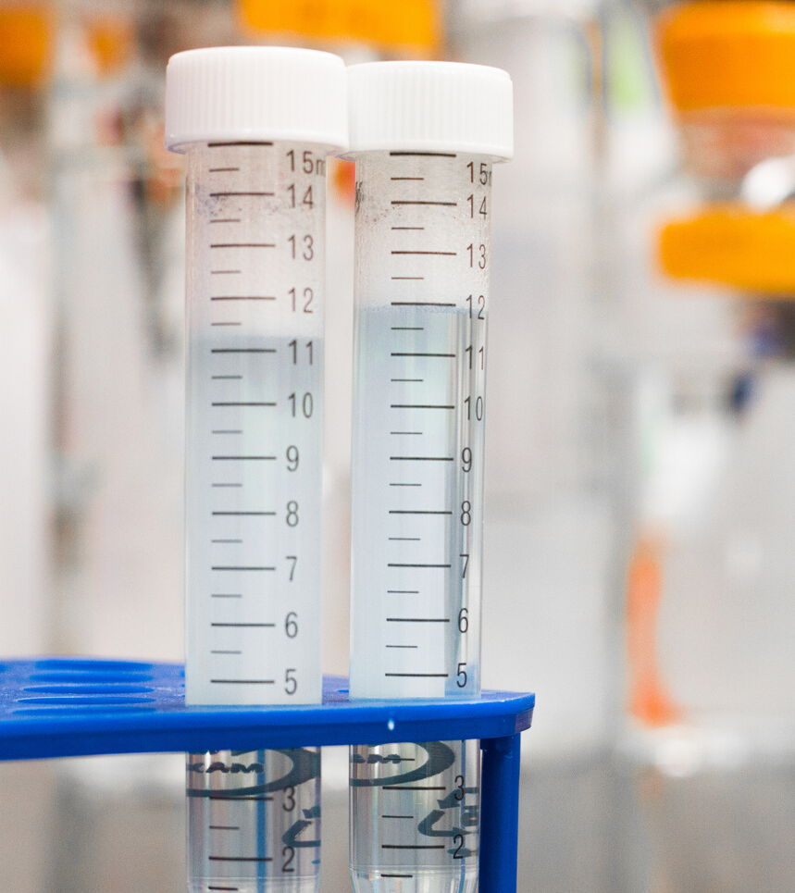
SIMA KUMAR
LC/MS/MS Analyst

