Slide 1
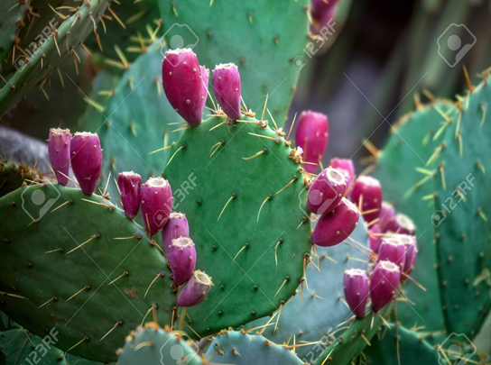
Method development for the analysis of Flonicamid and its metabolites in Prickly pear fruit / Pad by HPLC-MS/MS for PR# 11966.17
Sima R. Kumar and Les Geissel
IR-4, Michigan State University

Slide 2
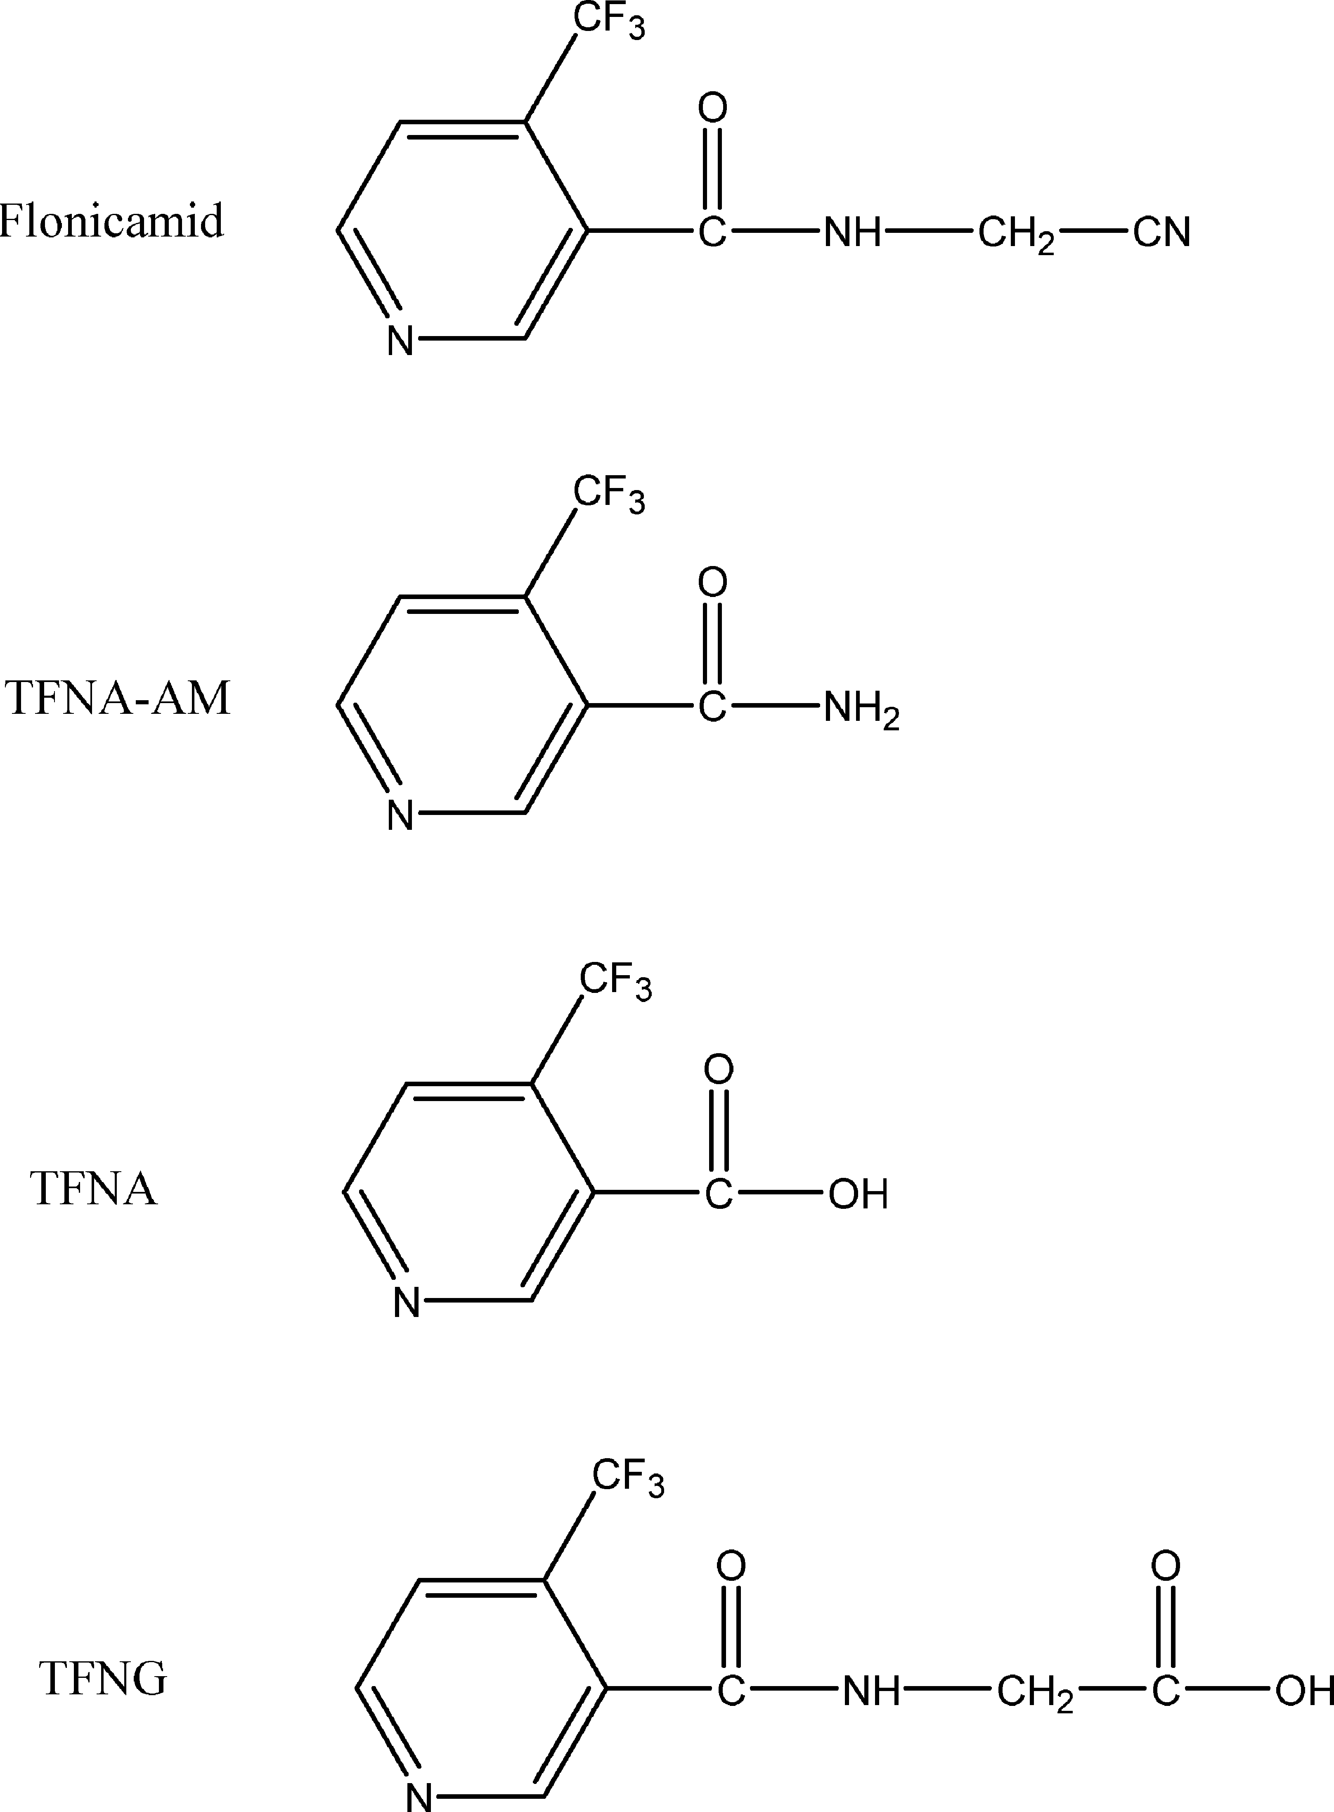
Molecular structures for Flonicamid and metabolites.

Slide 3
Flonicamid and its metabolites parent mass ions and daughter ions

Slide 4
An example of the chromatogram of Pad control with high concentration of TFNA-AM

Slide 5
An example of Fruit control chromatogram of prickly pear

Slide 6
An example of Spike sample of pad showing high concentration of TFNA-AM same as in control

Slide 7
0.001 ppm Std analyzed with 0.01 ppm Spike sample of Pad

Slide 8
Example chromatogram of Pad from store bought
All clean, no residue

Slide 9
10 µL inj was overloading the column and peak shapes were not good

Slide 10
4 µL injection did not give consistent results and overloaded the column

Slide 11
2 µL injection worked best without overloading the column

Slide 12
Flonicamid analysis of calibration standards at 2 µL Injections
Notes:
I want to tell everyone how yucky prickly pears are

Slide 13
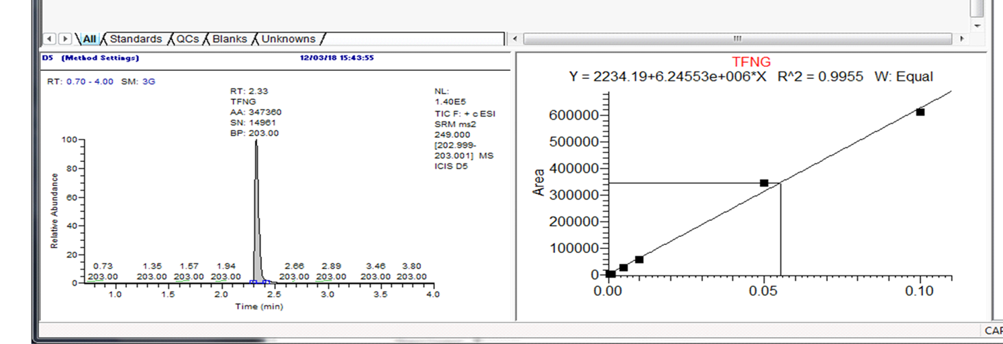
TFNG analysis of calibration standards at 2 µL Injections

Slide 14
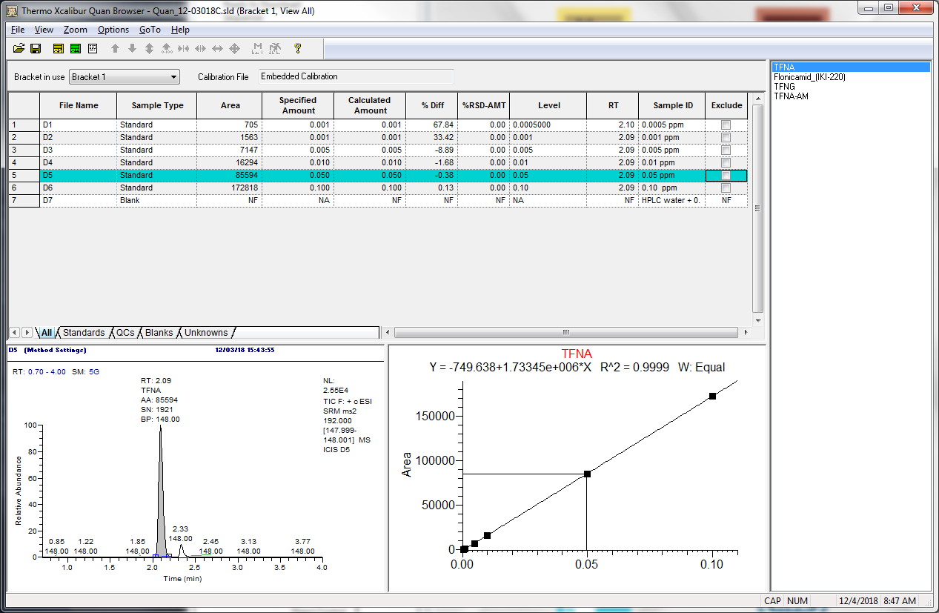
TFNA analysis of calibration standards at 2 µL Injections

Slide 15
TFNA-AM analysis of calibration standards at 2 µL Injections

Slide 16
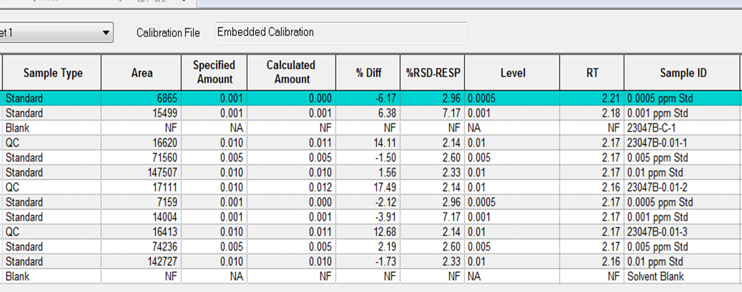
Results summary of Flonicamid on 0.01 PPM, MVS_Pads_PR#11966

Slide 17
Complete analysis with acceptable recoveries at all levels

Slide 18
Finally we were able to complete MV Studies with an acceptable recoveries at all thee levels

Slide 19

Thank you!
Any questions?

