Slide 1

Tricks of the Trade
Planning for a Successful Field Season

Slide 2

FRDs: “So what do you do all winter?”
Planning is key!!!

Slide 3
Draft Protocol Review
Why should I bother?
It’s your opportunity to suggest changes that will best fit your site/ equipment/personnel.
    SDs don’t know your facility’s setup and limitations.
    Can help avoid deviations and amendments

Slide 4
Draft Protocol Review
Questions you may ask yourself…
  Will this work at my site? (field space, equipment…)
  How can I adapt? (app/harvest modifications, GPA…)
  What’s new, what’s different? (IR-4 resources)
Be sure to review any SD revisions from draft to final protocol…

Slide 5
Test Substance/Adjuvants
Test Substance: compare protocol, container label and COA; expiration date
Adjuvant: type (NIS, COC, MSO…) and rate (label or % v/v)
Any issues contact SD asap!

Slide 6
Trial Scheduling/Field Planning
Questions you may ask yourself about your crops/trials…
When? (planning/tracking trials)
Where? (on-site, off-site)
How? (crop information)

Slide 7
Trial Scheduling/Field Planning
Other Considerations
SOPs: revised and up to date
Obtain seeds/transplants, growing media, fertilizer…
Check all equipment ahead of time
Coordination with drying or processing facility if needed

Slide 8
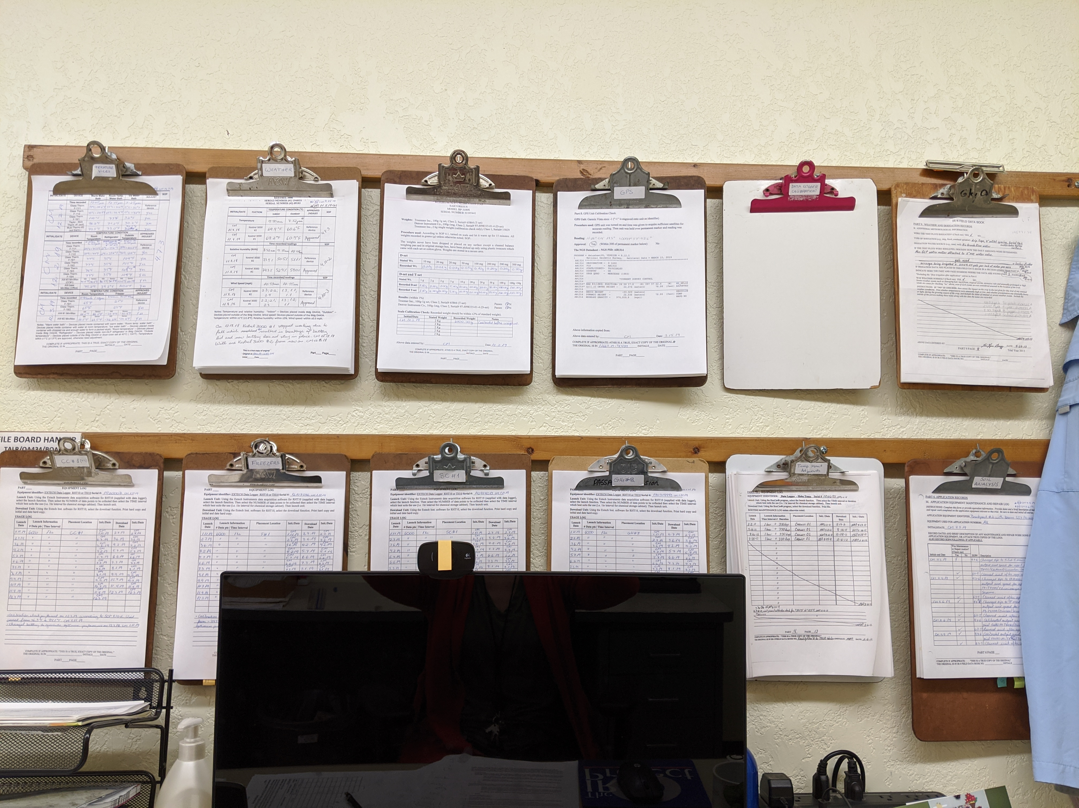
Data for Multiple Trials
Organize your shared data for current year trials and historical data.
Here is an idea:

Slide 9

Your Tricks of the Trade
Ideas to make our trials “a day at the beach”?

