Slide 1
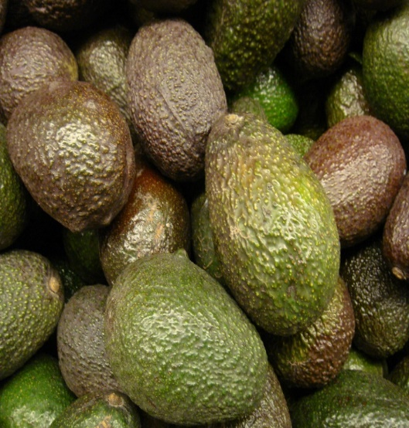
IR-4 Project Update
National Education Conference, San Diego
Notes:
I have included notes on many of the slides in this section on each slide

Slide 2
Update Topics
Mission – why we exist
Partnerships
People update
Program Highlights
Food use residue
International activities
Integrated solutions
Environmental horticulture
Fiscal update & Impacts of Move
Quality
Closing Remarks
Notes:
Check to be sure this is accurate with the modified slides

Slide 3
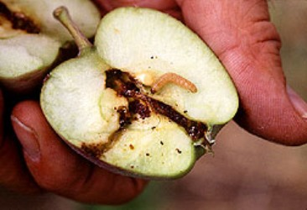
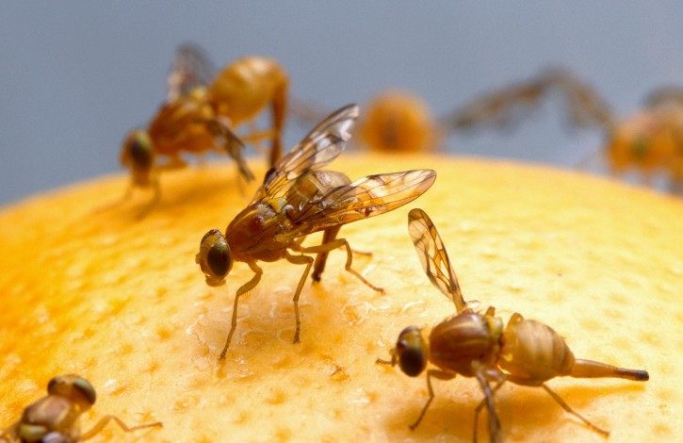
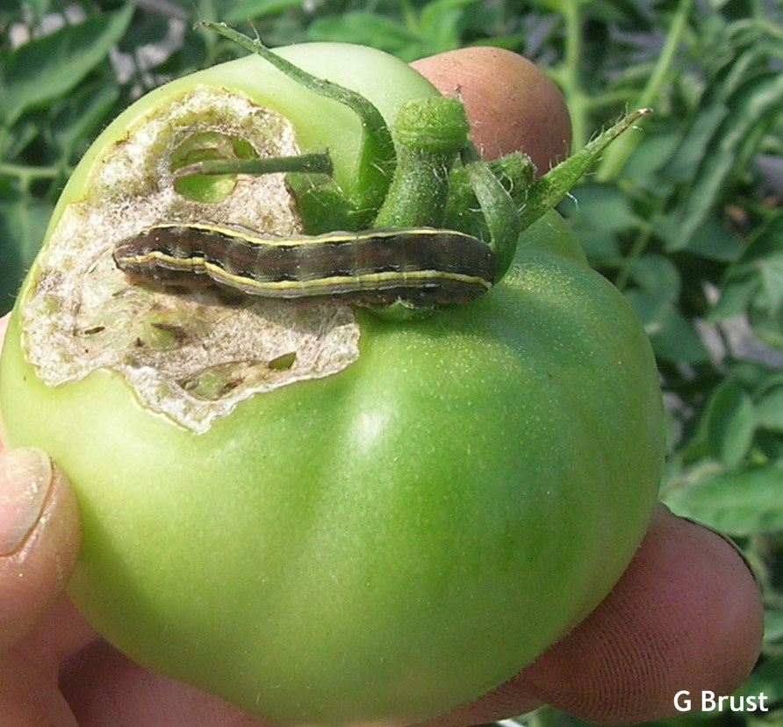
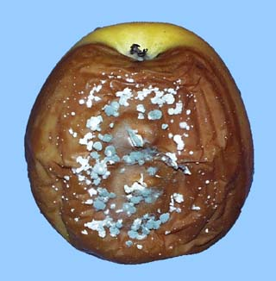
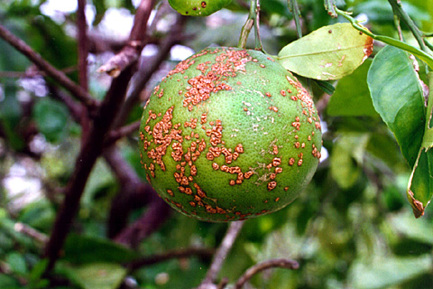
It Starts with the Pests!
Notes:
Delete
Same comment: Is this slide needed. It would seem that this can be communicated in the “benefits of pest management” slide

Slide 4
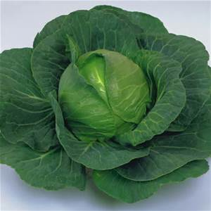
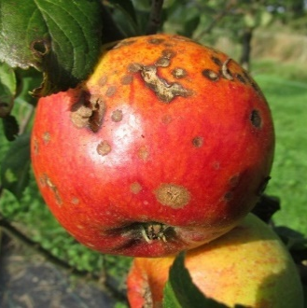
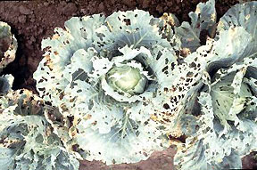
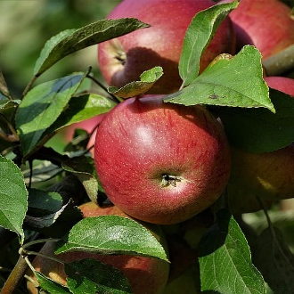
Benefits of Pest Management
Maintaining:
Healthy crops
Crop yields
Crop quality
Crop nutrition
Crop appearance
2020 has been Declared the International year of Plant Health

Slide 5
Benefits of Pest Management
2020:
International Year
of
Plant Health

Slide 6
Modern Minor Use Problem
Registrations are plentiful but ability to use approved crop protection products products may be limited
Export Issues
Efficacy Data Needs
Pest Resistance
Use Restrictions
Public Acceptance

Slide 7
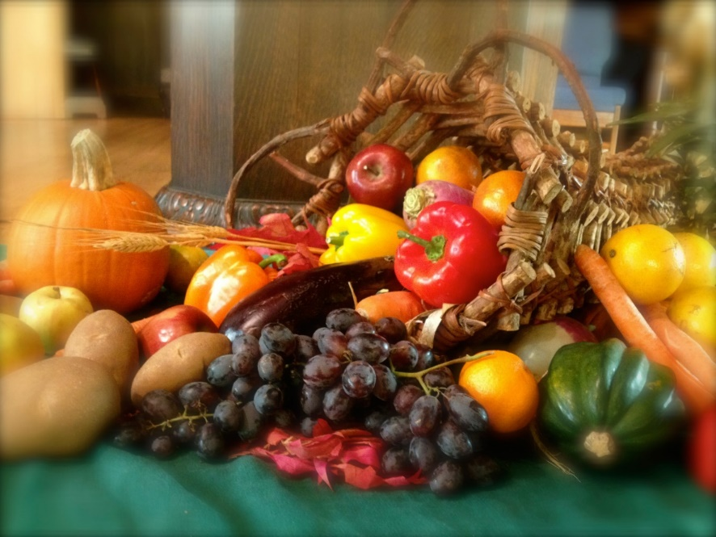
IR-4 Mission
Facilitating the regulatory approval of sustainable pest management technology for specialty crops and specialty uses to promote public well-being

Slide 8
The Value of Partnerships
Notes:
What is the main message that needs to be conveyed here?

Slide 9
People Update
Retirements
New Hires
Other Transitions
Notes:
What is the main message that you want to convey broadly about people? Be sure to verbally state those messages.
Suggest that you verbally acknowledge those retirements in a general or specific, but not list them on the slide (adds a lot of text)
Need to add a group photo – perhaps something from the FUW?
Add other bullets for main messages.
As you mentioned on our call this area is a fine line. I know that some people are upset and feeling they are not being treated fairly so it makes this communication tricky
Possible messages to consider stating
People and the knowledge they bring is a strength; acknowledge that:
In times of transition people are affected and this is a difficult and sensitive issue for any organization including ours?
Many, although supporting or understanding our move, have been faced with difficult personal decisions, and we want to be sensitive to that?

Slide 10
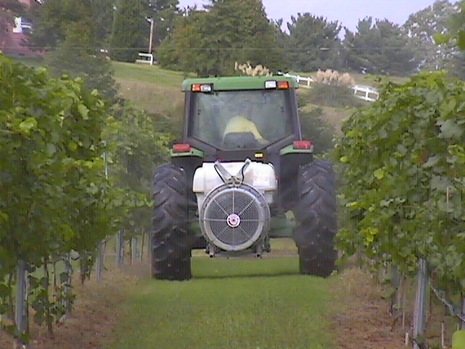
Food Crop Program
Guideline magnitude of residue studies
Product Performance (targeted)
Crop grouping expansion
MRLs / International
Integrated Solutions Program
Notes:
Initial signature objective or program
What are the main messages that you want to convey to this group from this slide? Who are you targeting in the audience with this information?

Slide 11
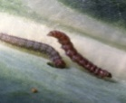
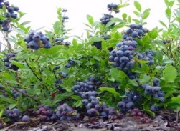
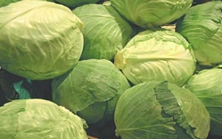
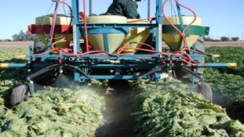
IR-4 Food Use Regulatory Clearance Process
Stakeholder:
Define Pest Problem
Identify Pest Management Solution
Request Assistance from IR-4
The Process Starts with Requests
Submitted from:
Growers
Grower Groups
State/Federal Research &
Extension Personnel
Request Reviewed by Manufacturer
Requests Prioritized
(
)
Stoplight
Analysis
Top Priorities Researched That Year
Other Priorities Researched as Money Allows
Field and Lab Research
Measure residue levels in crop samples (EPAregions.pptx)
Top priorities completed in ~30 months
Risk Assessment
Data Submitted to EPA
Manufacturer Adds Crop to the Product Label
Tolerance Established by EPA
Notes:
This slide is in need of updating. Although the idea is good the slide is busy, complex and not visually pleasing.

Slide 12
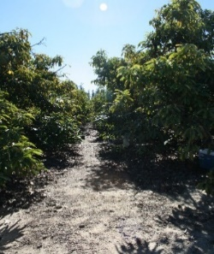
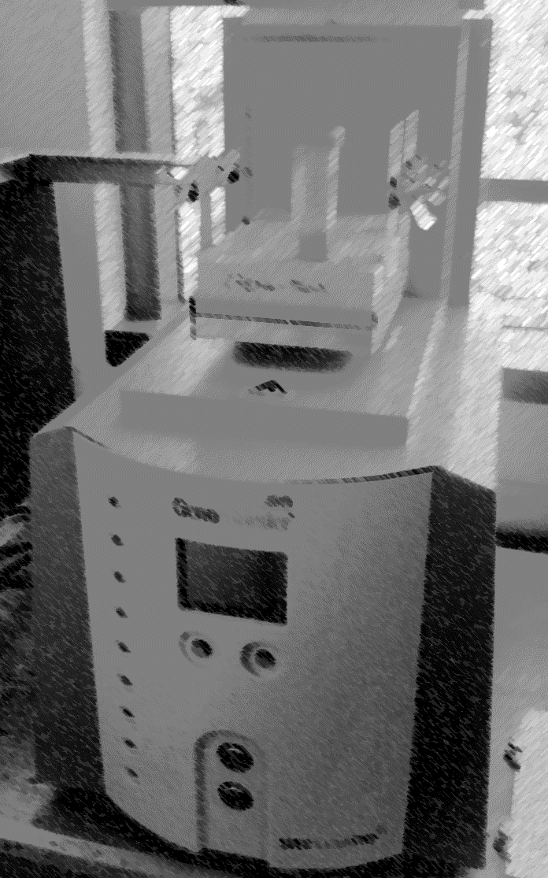
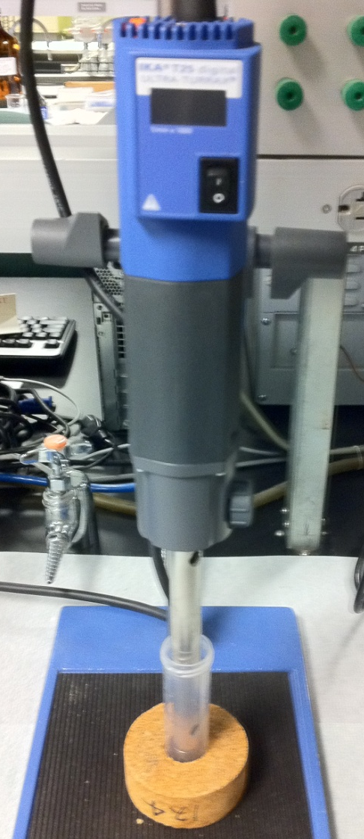
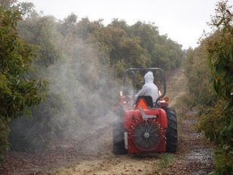
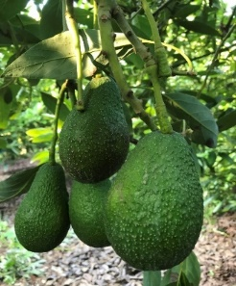
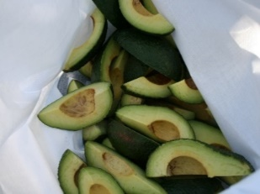
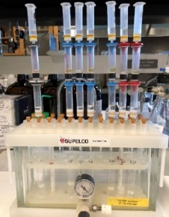
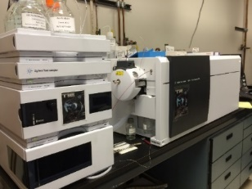
Food Crop Program 2019 Summary
Residue Research by the numbers:
72 studies
414 field trials
333 by US Regions
52 by ARS
29 by Canada
Declining number of studies and field trials
TASC & California grant offset
Eliminating laboratory backlog
Notes:
I moved this up before the record breaking slide. Consider if you want to reorder these. The numbers on this slide are not record breaking rather the trend is lower. The record breaking seems to be on the next slide

Slide 13
Food Crop Program Success
Registrations by the numbers:
1,545 new uses
208 tolerances established
21,358 clearances in 56 years
Notes:
Initial signature objective or program

Slide 14
International Activities
Involvement to address:
Lack of harmonized tolerances
Prevents U.S. exports
Efficiencies by working internationally
U.S. system vs. EU system
Minor Use Foundation
Notes:
Need to state what the Minor Use Foundation is and why we are involved

Slide 15
Integrated Solutions
Product screening
Conventional and biological products
Integration of chemical and biological pesticides
Integration of pesticide types to reduce the risk of MRL violations in export crops
Support for organic systems
Other practices
Biological Products
Conventional Chemistry
Notes:
I have reworded these to try to have brevity on the slide. Please review and modify as needed/desired

Slide 16
Integrated Solutions 2019 Summary
IR-4 initiated six Integrated Solutions research projects in 2019
Substantial improvements in priority setting
Database
Notes:
Need to add highlights

Slide 17
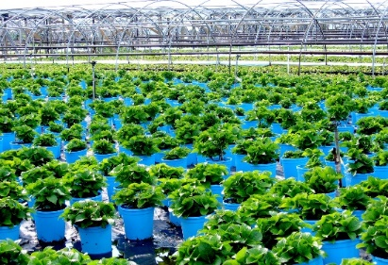
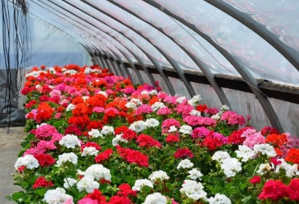
Environmental Horticulture Program
Crop safety and efficacy testing
Conventional and biological products
Label expansion is a major focus
Includes:
Floriculture
Environmental horticulture
Invasive pests
Aligned program
Pollinator protection
Notes:
Suggest that mention old name is not mentioned – (old news and doesn’t need to be highlighted)

Slide 18
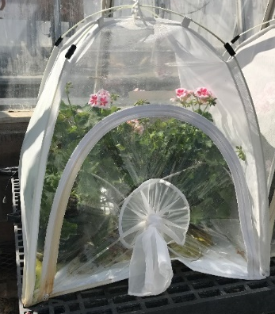
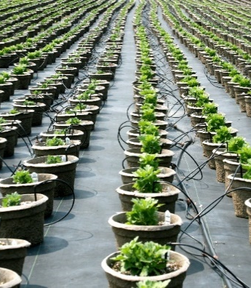
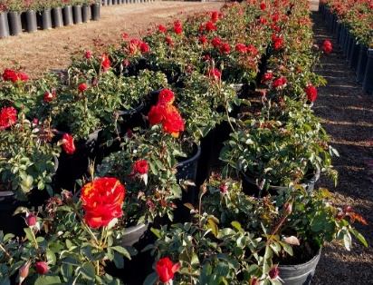
Environmental Horticulture 2019 Summary
Prepared and submitted 22 research project summaries.
IR-4 implemented 673 field trials.
US EPA issued three registrations supporting 2665 crop uses.
Notes:
Need to add highlights

Slide 19
Fiscal Update
Issue:
Decade of flat funding
University service fees (indirect costs)
Impact:
Fund fewer studies
Strategy (PMC/CLC):
Relocate HQ
Commodity Liaison Committee advocacy activities
“Right size” organization
New funding
to move forward
Flat funding
University fees
Implementing plan
Notes:
I have significantly changed this slide.
I suggest that the focus not be on the issue itself, but rather how you and the PMC and others are going to provide leadership to address this.
What I know I am looking for is for the leadership of IR-4 to acknowledge the challenges and let us know that they have a plan to move us forward in spite of the obstacles

Slide 20
Impacts of Headquarters Moving
Issue:
Disruption during move
Must remain operational
Personnel transitions
Impact:
Potential impact on registrations, studies and trials
Loss of institutional knowledge
Strategy:
Long transition to minimize disruption
Shadow organization
Modify structure to better address future specialty crop protection challenges
Notes:
For many this is not a concern. For those directly affected it is a big concern. There are impacts to the wider organization
Need to be sensitive to what is said because of people feeling hurt or left out or other
Don’t focus on advantages in this slide. They were there and are part of why a move occurred.
NEED TO ADD IMPACTS ans STRATEGIES TO ADDRESS

Slide 21
Organizational Model
Executive Director
Research Program Manger |  |  |  |  |  | Operations Manager |  | QA Manager |  | Senior Assoc. Director-Regulatory
EH Manager |  | Weed Scientist | Entomology | Plant Pathologist |  | Business Services Coordinator |  | QA Auditor-HQ |  | Scheduling Manager |  |  |  |  |  |  | International Activities |  | Regulatory Support
Assistant Manager EH |  |  | Research Assistant |  |  | Business Services Coordinator |  | QA Auditor-Field |  | Study Director 1 |  | Study Director 2 |  | Study Director 3 |  |  | Regulatory Support
Research Assistant |  |  |  |  |  | Data Systems |  |  |  | Study Director-4 |  | Study Director-5 |  | Research Assistant
Notes:
Consider adding an org chart. But provide guidance on how to interpret it.
Focus on the structure, not on who will be in which role. I do not think the slide has to be discusses at depth, but hitting the high level and showing that there is thought and direction behind the plan are important. (Many FRDs may not care about this – but many others in the room do – so a minute on the slide is appropriate without spending too much time.
The main message is that there is a plan that the PMC and you are working toward, to set us up well for the future, knowing that we face significant organizational and funding challenges.
This will show part of the vision of where we are going as an organization.
Avoid discussing specific names. I would also be careful about mentioning the status of the position announcements or who is staying or leaving or any special circumstances that are being made for specific individuals.

Slide 22
Major Organizational Challenge: Maintaining Quality
Issue:
Recently we have had two major issues arise around adherence to Good Laboratory Practices (GLP’s)
Issue at analytical laboratory
Issue with field data notebook
Therefore, taking time to address this here and in various sessions during this training event
Notes:
State the issue(s)
Provide an overview without naming names or regions, but enough to show it is serious

Slide 23
Major Organizational Challenge: Maintaining Quality
Remember:
GLP’s are the law!
GLP’s are not an option
We cannot cut corners or hide problems
Participants must be trained
Before starting activity
Before starting on-going continued education
Everyone must
“Do Their Job”

Slide 24
Major Organizational Challenge: Maintaining Quality
Impacts:
Potential legal action
Loss of credibility
Regulatory Agencies (EPA, USDA, international agencies)
Companies
Sponsors
Loss of funding
Loss of entire IR-4 Project
All our jobs
Delays in submission
Significant extra work

Slide 25
Major Organizational Challenge: Maintaining Quality
Strategy:
Triage vulnerabilities
Release updated Operational Handbook
REQUIRED training
Streamline data collection
Potential competency training
Holding people accountable
Notes:
Be prepared to state what “Holding people accountable means”

Slide 26
Major Organizational Challenge: Maintaining Quality continued
Streamline data collection
Field Data Book Editorial Review
Committee members
M. Ross (Chair),
R. Tannenbaum, R. Batts, A VanWoerkom, K. Samoil, M. James, M. Tolson, D. Ennes, J. Spies, T. Barkalow, S.Palmer
Field Data Book revisions
Parts 1- 4 revised for 2020
Part 6 (Output calibration) under review at this meeting for 2021
Part 5,7,8,9 being assessed
Protocol template modifications

Slide 27
Closing Remarks
2019
Some great successes
Some significant challenges
Let’s remember who we are doing this work for
Let’s remember and recommit to:
doing our work professionally
with full adherence to the GLP’s, and
with our best efforts
Notes:
Who we work for – use slide information:
Growers
Legal access to safe & effective pest management technology……grow high quality crops
Food Processors & Food Retailers
Consistent supply of raw materials
Economy
IR-4 contributes $9.4 Billion to annual US GDP/supports >95,200 jobs
Public
Plentiful supply of specialty crops that contribute to a healthy diet & plants that enhance the environment.

Slide 28
Acknowledgement
Dan Kunkel/Debbie Carpenter/John Wise/others
Tammy Barkalow/QA team
IR-4 HQ Team
Commodity Liaison Committee/Project Management Committee
NC State Administration
Notes:
Who we work for – use slide information:
Growers
Legal access to safe & effective pest management technology……grow high quality crops
Food Processors & Food Retailers
Consistent supply of raw materials
Economy
IR-4 contributes $9.4 Billion to annual US GDP/supports >95,200 jobs
Public
Plentiful supply of specialty crops that contribute to a healthy diet & plants that enhance the environment.

Slide 29
Acknowledgement
And most importantly:
All of You!
Notes:
Who we work for – use slide information:
Growers
Legal access to safe & effective pest management technology……grow high quality crops
Food Processors & Food Retailers
Consistent supply of raw materials
Economy
IR-4 contributes $9.4 Billion to annual US GDP/supports >95,200 jobs
Public
Plentiful supply of specialty crops that contribute to a healthy diet & plants that enhance the environment.

Slide 30
Questions?

