Slide 1
About The IR-4 Project

Slide 2
IR-4 Mission
Since 1963, facilitating the regulatory approval of sustainable pest management technology for specialty crops and specialty uses to promote public well-being

Slide 3

Specialty Crops Include:
Most:
Vegetables
Fruits
Nuts
Herbs
Spices

Slide 4
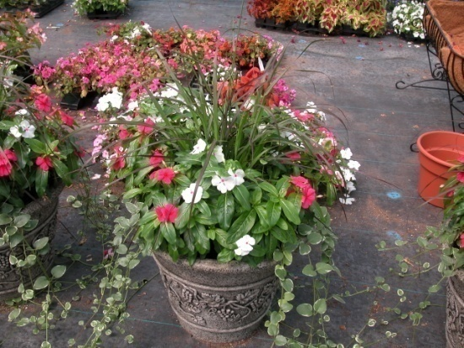

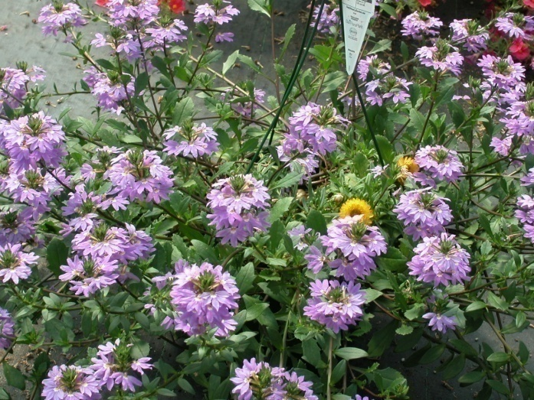
Specialty Crops Include:
Most: Greenhouse Nursery Landscape Christmas Trees

Slide 5
Value of Specialty Crops in US Agriculture
Defined by EPA as crops grown on <300,000 acres in US
are high value/low acreage crops
make up about 40 % of US agriculture productions > $83 billion in sales
at least 26 states derive more than 50% of agricultural crop sales from specialty crops

Slide 6
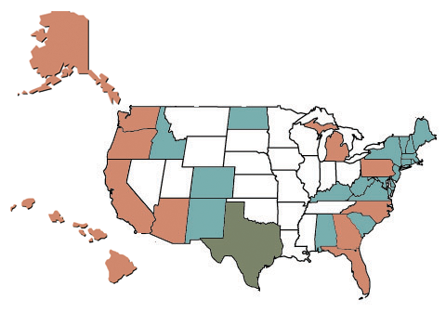
States where specialty crops comprise ~half of all crop production value

Slide 7


IR-4… is the ONLY
Publicly funded program that conducts research and submits petitions to EPA requesting approval of new tolerances and registration of new uses for pest management tools (herbicides/insecticides/fungicides/ plant growth regulators/biopesticides/pest control products for use in certified organic crop production, etc.)

Slide 8



Who Pays For It?
Major Funding for IR-4 is Provided By:
USDA-NIFA Competitive Grant and Hatch Act
Funds in cooperation with…
State Agricultural Experiment Stations, and
USDA-ARS
Additional Support Provided By:
USDA-APHIS
Commodity & Industry Partners
for Special Research Projects

Slide 9
Partnerships Make Things Happen
Crop Protection Industry
Partnerships with biopesticide
and chemical companies are crucial
Despite reorganizations within the chemical industry,
companies continue to work with IR-4 to develop minor
crop uses for their products
Alert chemical companies of potential market opportunities
Petition submission information sharing initiatives began in

Slide 10
Partnerships Make Things Happen
Commodity Liaison Committee (CLC)
Provide direct input to:
  Project Management Committee (CLC chair is voting member)
  Workshops – Food Use, Environmental, Global
Provide key interface with House and Senate Agriculture
Appropriations staff members
Efforts resulted in IR-4 budget increases for CSREES in FY 2005,
2008 & 2009 and ARS prior to FY 2004
Additional funding increases are needed to provide support for:
  Field residue projects
  Biopesticide and Environmental Horticulture programs
  Analytical instrumentation and field equipment used to conduct GLP residue trials

Slide 11
Partnerships Make Things Happen
Environmental Protection Agency (EPA)
EPA/IR-4 Technical Working Group:
Initiated in 1999, meets quarterly
IR-4 provides agricultural tours for EPA/USDA/NIFA personnel
Explores initiatives to facilitate minor crop tolerances
EPA reviews annual IR-4 residue program and potential new projects prior to the Food Use Workshop
IR-4 served as a leader with the agency on electronic petition submission

Slide 12

Partnerships Make Things Happen
California’s Department of
Pesticide Regulation (CDPR)
Part of EPA/IR-4 Technical Working Group since 2001
Partnership between EPA and CDPR facilitated by
IR-4 resulted in workshare petitions
Expanded number of IR-4 petitions reviewed
Great support from Senior Management and dedicated team

Slide 13
Partnerships Make Things Happen
Health Canada’s Pest Management
Regulatory Agency (PMRA) and
Agriculture and Agri-Food Canada’s
Pest Management Centre
Partnership with IR-4 began in 1996
First IR-4 work share petition with EPA was completed in 2002
In 2003, the Canadian government made a major funding commitment to minor crop growers through PMRA and AAFC
IR-4 workshare petitions with PMRA have been approved by NAFTA Technical Working Group

Slide 14

Partnerships Make Things Happen
Land Grant Universities
Land Grant System and In-Kind support is valued at over $18,000,000 annually
They provide:
Analytical Laboratories
Offices
Research Farms
Infrastructure and Administrative Support
Pest Management and Crop Expertise

Slide 15
IR-4 National Headquarters
Located at Rutgers University in New Jersey
Responsible to manage and coordinate the day to day activities of the program
Staffed with 28 full time Scientists, Coordinators & Administrative Personnel

Slide 16
Who Does the Work?
IR-4 HQ
IR-4 Regional Program Office

Slide 17
State Satellite Labs & Field Research Centers
Hawaii
=
State Satellite Labs
Puerto Rico
=
State Field Research Centers/Food Use
State Field Research Centers/Ornamentals
and Non-food Use

Slide 18
USDA-ARS Labs and Field Research Centers
ARS Labs
ARS Field Research Centers/Food Use
ARS Field Research Center/ Ornamental
ARS Field Research Centers/
Food Use Ornamentals and Non-Food Use

Slide 19
Field Trials and Residue Analyses Sites Across the U.S
IR-4 HQ
IR-4 Regional Program Office
State Field Research Centers/Food Use
State Field Research Centers/ Ornamentals and
Non-food Use
ARS Labs
Hawaii
=
ARS Field Research Centers Food Use
Puerto Rico
=
ARS Field Research Centers Ornamental
ARS Field Research Centers Ornamental and Food Use

Slide 20
Project Management
Committee (13 Members)
IR-4 Executive Director (HQ)*
Regional Directors (4) *
ARS Program Staff Officer *
Administrative Advisers (4 NIFA Regions and 1 ARS)
Chair, Commodity Liaison Committee *
(The CLC has >30 members; only the chair is a PMC member)
USDA/NIFA National Program Leader
* Voting members
IR-4 HQ, Rutgers University — Study Directors, QA Manager, HQ Staff
USDA-ARS, Charleston, SC — ARS Labs and Field Stations
4 Regions — Univ. of California, Davis; Univ. of Florida; Rutgers Univ./Univ. of MD; Michigan State Univ.
Regional Directors Oversee:
    Regional Field Coordinator
    Regional Lab Coordinator (except Rutgers/Univ. of MD)
    Regional QA Coordinator
All units work under the umbrella of the Project Management Committee

Slide 21
IR-4 Project Objectives
  Food Crop Program
  Environmental Horticulture Program
  Biopesticide & Organic Support
  Integrated Solutions
Notes:
Sustainable in the manner that the new products being registered are more IPM compatible and we also register products for organic production and other biopesticides.

Slide 22
Enhanced Activities
1963
Food Program
1990 – 2000’s
-FIFRA 88
-GLPs
-FQPA
-Reduced risk
-Crop group updates
-International MRLs
-Invasive pests
-Public Health Pests
-Integrated Solutions
1970 and 80’s
-Environmental (was Ornamental Hort.) Program
-Regional Offices
-ARS program
-Biopesticide program

Slide 23
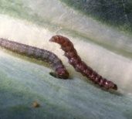
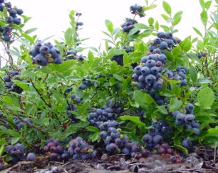
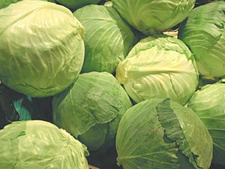
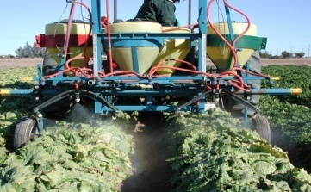
https://www.ir4project.org/submit-a-request-food-crops/
The IR-4 Food Use Regulatory Clearance Process
Stakeholder:
Define Pest Problem
Identify Pest Management Solution
Request Assistance from IR-4
The Process Starts with Requests
Submitted from:
Growers
Grower Groups
State/Federal Research &
Extension Personnel
Request Reviewed by Manufacturer
Requests Prioritized
(
)
Top Priorities Researched That Year
Other Priorities Researched as Money Allows
Field and Lab Research
  Measure residue levels in crop samples (EPAregions.pptx)
  Top priorities completed in ~30 months
Risk Assessment
Data Submitted to EPA
Manufacturer Adds Crop to the Product Label
Tolerance Established by EPA

Slide 24
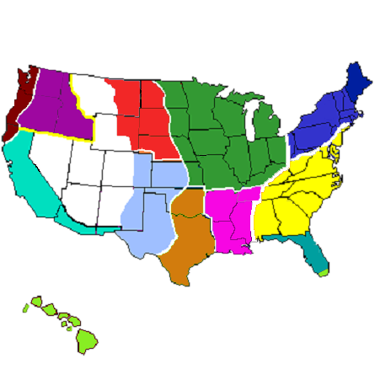
EPA Crop Production Zones
12
11
7
1
5
9
10
8
2
4
6
3
13

Slide 25

30 Month Timeline
30 Month Timeline
Project Initiation –
sign the Protocol
Analytic Phase –
analyze samples
Submit report to EPA
10th month
30th month
0-month
Quality
Assurance
Review
GLP
Field Phase –
apply test sub.
Petition Prep –
prepare report
2nd month
22nd month

Slide 26
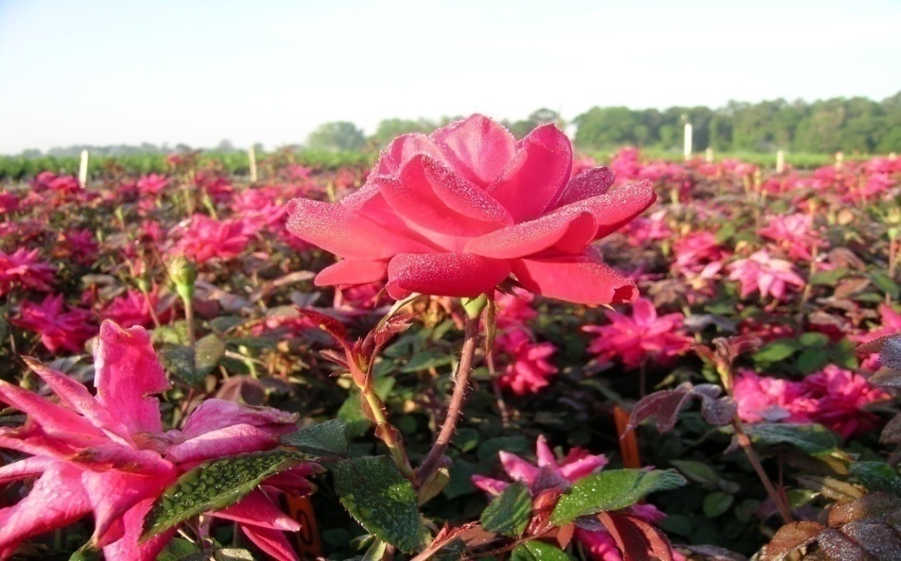

IR-4 EnvironHort Program
Established 1974; renamed Environ. Hort in 2018
10% of the Project’s efforts and resources
  Primarily develops efficacy and crop safety data for manufacturers to write product use directions

Slide 27
Biopesticide and Organic Support Program
Formally established in 1982
activities before 1982: regulatory assistance w/Bacillus thuringiensis, Bt
1982-1994: mostly regulatory assistance
1995-2013
regulatory assistance/submissions to BPPD at EPA
~10% of IR-4 efforts and resources in this area
grants-based research program per researcher interests; funded early,
advanced and demonstration (co-funded by EPA) research proposals
2008 – became “Biopesticide and Organic Support Program”
2014 - present
directed research program, based on priorities set by stakeholders
regulatory assistance continues

Slide 28
Biopesticide Program “Signature Successes”
- Codling moth Granulosis Virus
- AGRIPHAGES for bacteria control, including canker in greenhouse tomato
- Numerous biopesticides for management of mites in/on honeybees
- Extract of giant knotweed to manage diseases on many crops → REGALIA
- AF36 to manage aflatoxin on many crops
- Honeysweet plum variety modified to resist Plum Pox virus
- “All Crop” tolerance for spinosad → Broad ENTRUST label for organic crops

Slide 29
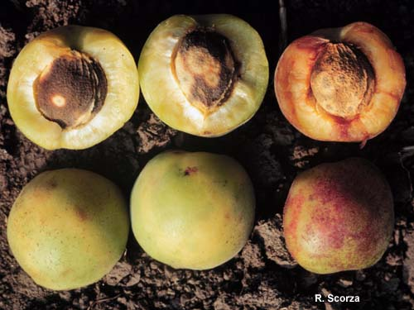
HoneySweet Plum - Transgenic resistance to Plum Pox Virus
Ralph Scorza –USDA-ARS Kearnysville, WV
IR-4 provided regulatory expertise to achieve EPA registration

Slide 30
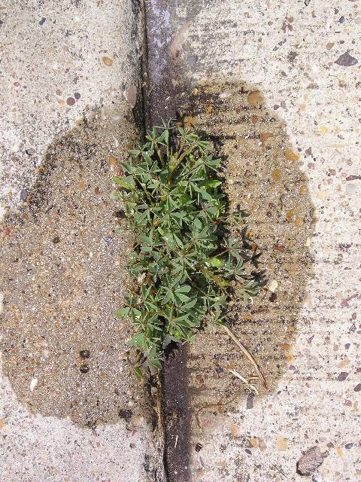
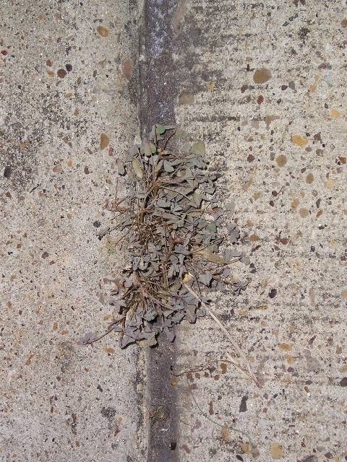
Acetic Acid (Vinegar) as an Organic Herbicide (20% concentration)
Registered by EPA

Slide 31
Research Reorg in 2018
Biopesticide Research being consolidated into Food Use & Environmental Hort Programs
Minimal impact on Environmental Hort Program
Initiation of Integrated Solutions Research (1st project prioritization at 2018 Food Use/Biopesticides Workshop in St. Louis):
  Screening studies to identify possible solution(s) - formally Pest Problem Without Solution & majority of Biopesticide Projects
  Residue mitigation studies
  Resistance Management studies
2019 is transition year, some traditional biopesticide projects, some Integrated Solutions studies

Slide 32
IR-4 Strategies
Focus efforts on Reduced Risk products
Develop registration strategies with product registrants
Develop successful partnerships
Get involved in International activities that help U.S. growers of specialty crops

Slide 33
1) Reduced Risk Strategy
Focus research efforts on Reduced Risk products
– 1993 EPA policy to expedite the registration of products with less risk to human health and environment
– since 2000, about 80% of IR-4 research has involved Reduced Risk products, or those classified as OP replacements
Support and register new pest control products essential to Integrated Pest Management, and compatible with pollinators
Registration of biologically-based pest control products

Slide 34
2) Registration Strategies
Start research on new chemistries before the first food use tolerance (i.e., chlorantraniliprole, flupyradifurone, oxathiapiprolin, etc.)
Use representative crops to obtain tolerances for entire crop groups or crop subgroups (https://www.ir4project.org/crop-grouping/)
Use “Super Crop Group” concepts for reduced risk products to increase efficiencies

Slide 35
3) Partnerships
Land Grant Universities
Land grant system and other in-kind
support is valued at over
$16 million annually
They provide:
GLP laboratories, office space
Research farms, administrative
support
Crop & pest management expertise

Slide 36
3) Partnerships (cont’d)
Crop Protection Industry
Partnerships with agrochemical companies are crucial –
without their products and approvals to expand labels to
add specialty crops ………
IR-4 alerts companies of potential market opportunities
(Dow/quinoxyfen powdery mildew example)
Work closely with companies year-round to gain current
product information & coordinate submissions to EPA
IR-4 must obtain company registration packages to submit
to EPA – requires very close cooperation

Slide 37































Industry Partners
ADAMA

Slide 38
3) Partnerships (cont’d)
Commodity Liaison Committee
Provides direct input to:
Project Management Committee
Priority-setting Workshops
Provide key interface with U.S. House and Senate
Agriculture Appropriations staff members
Efforts resulted in IR-4 budget increases in 2004,
2005, 2008, 2009 and 2010; minimized
budget reductions in 2011-2013; and maintained
level funding other years

Slide 39
Environmental Protection Agency (EPA)
EPA/IR-4 Technical Working Group:
initiated 1999, meets several times/yr; annual educational bus tours
Explores initiatives to facilitate minor crop tolerances; super crop group proposals on azoxystrobin and spinosad saved over $1M in taxpayer $$s
EPA reviews annual IR-4 residue program, and provides input on registrability of proposed new uses before project prioritization; ~50% of annual new tolerances EPA approves are based on IR-4 submissions
Leadership with agency on electronic petition submissions

Slide 40
CA Dept. of Pesticide Regulation (CDPR)
Partnership initiatives started in 2000
Partnership between EPA and CDPR facilitated by IR-4 resulted in workshare on 20 to 30 IR-4 petitions each year
This workshare has focused on IR-4 petitions for new uses which are particularly critical for CA specialty crop growers

Slide 41
Canada (NAFTA)
Health Canada’s Pest Management
Regulatory Agency (PMRA) and Agriculture
and Agri-Food Canada’s (AAFC) Pest Management Centre (PMC)
Partnership with IR-4 began in 1996 - several hundred cooperative
Canadian field trials have been completed
First PMRA/EPA joint petition review completed in 2002 – a decision
is required in 8-12 months
In 2003, the Canadian government made a major funding
commitment to minor crop growers through PMRA and AAFC =
“IR-4 North!”
Each year we organize 15-20 joint studies, with field trials conducted
in each country, and Canada PMC serving as Sponsor of several

Slide 42
4) IR-4 International Activities
Global leadership
    - Global Minor Use Summit I, II and III (2007 & 2012 & 2017) –
    created Global Minor Use portal on the IR-4 website (http://www.gmup.org/)
    - global tomato residue study (27 trials/22 countries)
    - global blueberry residue study (28 trials/9 countries)
    - global harmonization of crop groups and MRLs
    - involved in multi-national submissions and global registrations
    - involved in various Int’l regulatory groups (JMPR/CCPR/Codex)
    - capacity building with FAS – Thailand, Africa, Columbia, Brazil,
    Costa Rica, others
    - global priority-setting workshops, Sept. 2015 & Oct. 2017
Notes:
Modeled after success with Canada
Cooperating with Australia in 2007
Global Minor Use Summit
Dual front approach to MRL issue
Reformat/submit old data
Cooperate on new uses
IR-4 is a domestic program for domestic growers, Why involved in Global Harmonization?
IR-4 has provided domestic growers with access to numerous new pest management tools. These are OK to use if crop sold in US. Often significant problems if produce is exported. Growers forced to use older pest management tools.
This is a serious issue to many commodity groups
42

Slide 43
IR-4 Successes
Since its inception, IR-4 has facilitated:
  Registration of ~19,000 food crop uses
  Registration or amending of >170 ornamental product labels, impacting >44,000 crop uses
  Registration of numerous biopesticides (sprayable Bt, spinosad for organics, etc.)
  Registration of Plum pox resistant stone fruit

Slide 44
Economic Impact of IR-4
The Michigan State University Center for Economic Analysis (Dec. 2017) report
For a combined total budget of ~$18 million, the IR-4 Project contributes/supports
  over $9.4 billion to annual US Gross Domestic Product
  over 95,000 jobs throughout the United States.

Slide 45
IR-4’s Future??
After 54 years, the needs are still there, maybe more than ever
Continue to address grower needs; there is significant specialty crop growers’ support
Latest/safest pest control tools
Invasive species research
Enable expansion of U.S. exports

Slide 46
For More Information Contact …
Northeast Region
Ms. Marylee Ross
Regional Field Coordinator
Univ. of Maryland
410-742-8788 ext. 310
mross@umd.edu
North Central Region
Dr. Anthony VanWoerkom
Regional Field Coordinator
Michigan State Univ.
517-336-4611
vanwoer3@anr.msu.edu
Southern Region
Mr. Roger Batts/Dr. Janine Spies
Interim/Regional Field Coordinator
NC State Univ./Univ. of FL
919-515-1668/352-294-3991
rbbatts@ncsu.edu/jrazze@ufl.edu
Western Region
Mr. Michael Horak
Regional Field Coordinator
Univ. of CA, Davis
530-752-7634
mjhorak@ucdavis.edu
USDA-ARS Office of Minor Use Pesticides
Dr. Alvin Simmons
IR-4/ARS Coordinator
843-402-5307
alvin.simmons@ars.usda.gov
IR-4 Headquarters
Dr. Jerry Baron
Executive Director
732-932-9575 ext. 4605
jbaron@njaes.rutgers.edu
Each State has an IR-4 State Liaison
Visit the IR-4 Web Site To Learn More…
https://www.ir4project.org/

Slide 47


Thank You!

