Slide 1
IR-4 Biopesticide & Organic Support Program

Slide 2
Biopesticides
Develop data to support biopesticide registrations with emphasis on integration of biopesticides into conventional systems
Resistance Management
Residue Management
Support for organic markets
Biotechnology-Plant incorporated protectants

Slide 3
Biopesticide Research
Formally Established in 1982
Some activities prior to 1982: regulatory assistance w/ Bt
1982-1994
Mostly regulatory assistance
Some funding of research
1995-2003
Regulatory assistance
Early stage research
Advance stage research (1999)
Pilot Demonstration Program
First year was $100,000 program ($80,000 from BPPD)
Second and Third Years were $200,000 Program Each Year ($100,000 from BPPD)
Began Setting Priorities via Workshop voting process in 2015

Slide 4
Recently Funded Workshop Priorities
Fruit
Blueberry Gall Midge
All Crops / Brown Marmorated Stink Bug; Plant Bugs, Lygus B00029; B00028
Apple / Fire Blight (Erwinia Amylovora) B00324
Residue Mitigation trials in blueberry
Organic
Cucurbit; Pumpkin; Squash; Basil; Hops / Downy Mildew B00149; B00127; B00124; B00108
Fruit / Spotted Wing Drosophila B00135
Other
Weed Screening
All Crops / Weeds B00102
Varroa mite in Honeybees
Phorid fly control in Mushroom
Vegetable
GH Tomato / Virus And Viroid B00311
Fruiting Vegetables (Field And GH); Onion / Bacterial Diseases B00114; B00094

Slide 5
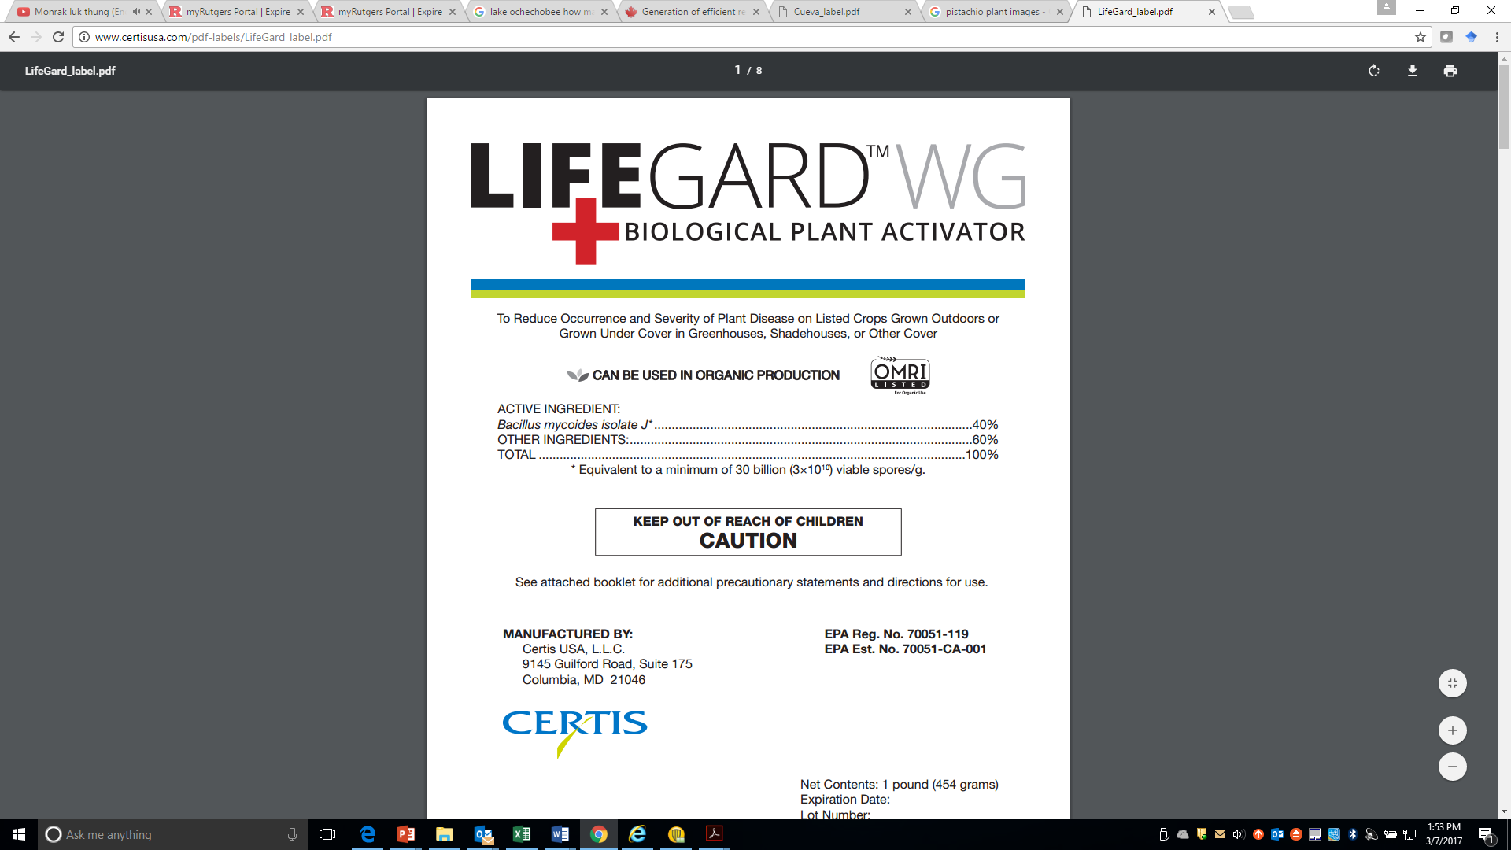
Dr. Barry Jacobsen
Montana State University
IR-4 provided some of the initial regulatory guidance and funded several efficacy trials that contributed to the registration

Slide 6
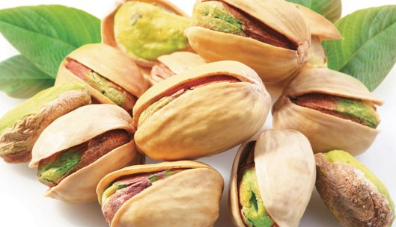
ASPERGILLUS FLAVUS AF36
Submitted EPA registration package and registration decision on new formulation to CDPR to support registration on Cotton, Corn and Pistachio, Almond and Figs

Slide 7
Regulatory Assistance Requests
Provides Assistance with EPA Registration
Of Biopesticides.
New Active Ingredients
Small companies, USDA, University
Arranging meetings with EPA
Prepare literature reviews- Exposure/Scientific rationale to meet toxicology requirements
Formatting documents, forms, write label, modification
Communication, Negotiation
Submit registration package and tolerance petitions

Slide 8
Signature Successes
Codling Moth Granulosis Virus
AGRIPHAGES for bacteria control, including canker in greenhouse tomato
Numerous biopesticides for management of mites in/on honeybees
Extract of giant knotweed to manage diseases on many crops → REGALIA
AF36 to manage aflatoxin on many crops
Honeysweet varieties of stone fruit that is modified to resist Plum Pox
“All Crop” tolerance for spinosad → Broad ENTRUST label for organic crops

Slide 9
Thank You!

