Slide 1
Crop Grouping

Slide 2
Crop Grouping
Basic Concept: Crop Grouping is used to facilitate the establishment of pesticide tolerances for a large number of crops based on residue data from selected representative crops
Crop Group: A group of crops that are botanically or taxonomically related.
A crop group includes representative crops.

Slide 3
Crop Grouping - Definitions
Representative Crop(s): Crops in a crop group whose residue data can be used to establish a tolerance on the entire crop group or subgroup.
Generally the highest residues and most economically important
Crop Subgroup: More closely related crops in a crop group that are divided into smaller groups with one or more representative crops.

Slide 4
Crop Grouping - Revisions
Why Revise Crop Groups:
No new crop groups were developed since 1995 because of regulatory constraints
Many orphan crops not included in a crop group
US population more diverse with new ethnic foods available
Increased globalization of markets, trade
Need to facilitate import tolerances
Need for international harmonization (Codex) of crop groups, definitions and vocabularies

Slide 5
Crop Grouping - Benefits
Without Crop Grouping would need to do a separate study for each crop.
Fruiting Vegetable CG: Conduct studies on 3 Representative Crops - Tomato, Bell Pepper and Non Bell Pepper - obtain a tolerance on 19 crops – So conduct 3 studies instead of 19 studies.
Average cost of a study is $110,000, total savings for this crop group would be over $2.0 Million.

Slide 6
Crop Grouping - Benefits
Save Research $$$$: Assume each study costs $110K. Approx 300 crops will be added when finish Herbs and Spices = 300 X $110K = Potential $33M in savings just to date…
IR-4 Labs can operate more efficiently
Growers benefit by obtaining labeled uses more quickly.
EPA saves time and personnel in reviewing tolerance petitions.
IR-4 Centers operate more efficiently concentrating on only representative crops.

Slide 7
Example of ChemSAC Approval
Current | Rep Crops: | Member Crops (6):
Fruiting Veg. (except cucurbits) | Tomato, Bell Pepper and one cultivar of non bell pepper | Eggplant, Groundcherry, Pepino, Pepper, Tomatillo, Tomato
Revised: | New Subgroups: | Added Crops (+13):
Fruiting Veg. (except cucurbits) | Tomato 8A Pepper/Eggplant 8B Nonbell pepper/Eggplant 8C | African eggplant, Bush tomato, Cocona, Currant tomato, Garden huckleberry, Goji Berry, Martynia, Naranjilla, Okra, Pea eggplant, Roselle, Scarlett eggplant, Sunberry, Tree tomato

Slide 8
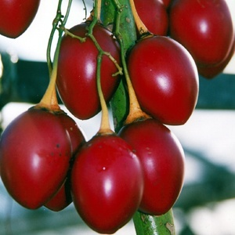
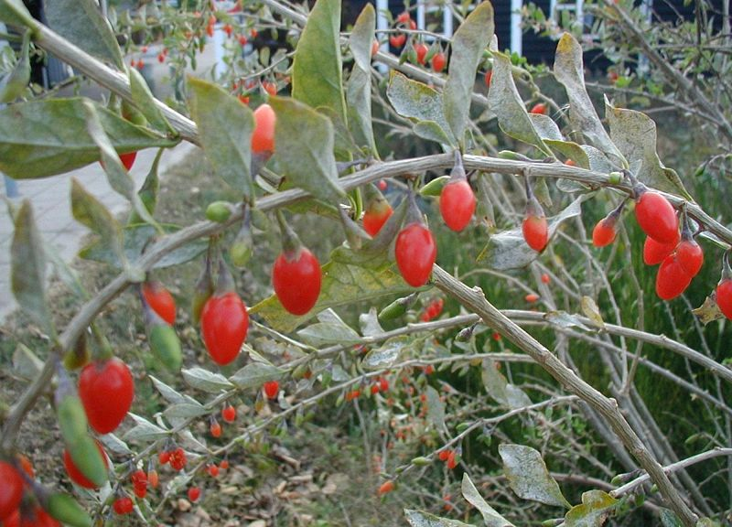
Additions to Fruiting Vegetables CG
Tree Tomato
Goji Berry

Slide 9
Progress and Accomplishments
All 21 U.S. crop group petitions have been submitted to the EPA
14 have been published in the Federal Register
8 have been approved by ChemSAC
1 under review by HED Scientist (Herb & Spice)
Cucurbit Vegetables under HED Scientist review

Slide 10
Crop Groups – Web Site
All Crop Groups, Subgroups, Representative crops and Crop Definitions can be found on the IR-4 Web Site:
http://ir4.rutgers.edu/Other/CropGroup.htm

Slide 11
Crop Grouping
US, EU and Codex Crop Groups undergoing revision
US/NAFTA Crop Groups being revised based on IR-4 petitions, which are developed from work of EPA/OPP, USDA, International Crop Grouping Consulting Committee (ICGCC)
Codex revising Codex Classification of Foods and Animal Feeds - based on work of ICGCC/EPA/IR-4
EU revising Crop Groups as part of new Reg (EC) 396/2005
Others as well, Brazil, India, Taiwan, etc….
The expectation is to have the Codex be the authority/basis of crop groups.

Slide 12
Fruit type
Crop Group | NAFTA | Codex | Type (Codex)
Berry & Small Fruit Group | Codified | Adopted | Fruit
Pome Fruit Group | Codified | Adopted | Fruit
Citrus Fruit Group | Codified | Adopted | Fruit
Stone Fruit Group | Codified | Adopted | Fruit
Tropical Fruit Groups | Codified | Adopted | Fruit
Berry & Small Fruit Group | Codified | Adopted | Fruit
Pome Fruit Group | Codified | Adopted | Fruit
Citrus Fruit Group | Codified | Adopted | Fruit
Stone Fruit Group | Codified | Adopted | Fruit

Slide 13
Vegetable type
Crop Group | NAFTA | Codex | Type (Codex)
Bulb Vegetable | Codified | Adopted | Vegetable
Fruiting Vegetable | Codified | Adopted | Vegetable
Stalk, Stem and Leafy Petiole | Review complete | Adopted | Vegetable
Leafy vegetables | Review complete | Adopted | Vegetable
Brassica Head/Stem Vegetable | Review complete | Adopted | Vegetable
Root/Tuber Vegetable | Review complete | Adopted | Vegetable
Edible Fungi Group | Codified | Adopted | Vegetable
Legume Vegetables | Submitted | Adopted | Vegetable
Cucurbit Vegetable | Submitted | Adopted | Vegetable

Slide 14
Other Commodity Types
Crop Group | NAFTA | Codex | Type (Codex)
Tree Nut Group | Codified | Adopted | Nuts and Seeds
Oilseed Group | Codified | Adopted | Nuts and Seeds
Tropical trees and shrubs for Bev and sweets | NA | Adopted | Nuts and Seeds
Herbs and Spices | Review complete | Adopted | Herbs and Spices
Cereal Grains | Submitted | Adopted | Grasses
Forage/Fodder/ Straw of Cereal Grains | Submitted | Submitted | Grasses
Grasses for sugar or syrup | NA | Adopted | Grasses

Slide 15
Thank You!

