Slide 1
International Activities

Slide 2
2014 Farm Bill
International Harmonization of MRL’s and Registrations was added to IR-4 Project authorization to “The Agricultural Act of 2014”.
INTER-REGIONAL RESEARCH PROJECT NUMBER 4.—Subsection (e) of the Competitive, Special, and Facilities Research Grant Act (7 U.S.C. 450i(e)) is amended in paragraph (4)
(E) assist in removing trade barriers caused by residues of pesticides registered for minor agricultural use and for use on domestically grown specialty crops;

Slide 3
IR-4’s Efforts in International Cooperation
NAFTA Technical Working Group On Pesticides and
RCC
PMRA
Canada
Brazil, Costa Rica, New Zealand MOUs
EPA
Global
Work-Shares & Joint Reviews
OECD
Expert Groups
Guidelines
MRL
Harmonization
China ICAMA Chair of CCPR
PMC
Canada Minor
Use program
Codex/JMPR work
EU – EFSA
Regulation
(EC)396/2005
ASEAN Harmonization of MRLs
Crop Life International
Notes:
The many areas, groups and partnerships that we have developed. I should probably note the Minor Use summits here, but the partnerships are an outcome form the summits.

Slide 4
International Use of IR-4 Data
Codex/JMPR
Work with commodity groups and EPA to add uses (chemicals) to JMPR work plan
Review JMPR work plan and dovetail IR-4 data with chemicals scheduled for review
Work with EPA and Registrants to submit data to JMPR
Nominate Chemicals for JMPR review
Consider working with other countries to nominate chemicals or add commodities to JMPR workplan
Notes:
JMPR Joint meeting (WHO and FAO) of Pesticide residues. WHO does the risk assessment and FAO does the chemistry reviews
IR-4 sends their list of Dovetails to stakeholders each year in the spring as a notification of our activities.

Slide 5
International Use of IR-4 Data
MRL Harmonization include:
Hop for EU market
Citrus and Berry for Asia market
Cranberries to the EU maket
IR-4 willing to share existing data as long as the use is registered in the US

Slide 6
Global Residue Studies
Global Zoning Study w/Tomato
4 ai’s/28 locations
key part of EPA & PMRA’s global exchangeability proposal
Blueberry – IR-4 managed a GLP residue study in various regions
Harmonized MRL established & use is registered

Slide 7
IR-4 International Activities
IR-4 supports US Exports by removing pesticide residues as a trade barrier and is active in the following areas.
NAFTA
Support Existing Tolerances (US Exports)
Leadership – NAFTA, OECD, Codex
Research
Global residue studies
Tomato & Blueberry
Capacity building

Slide 8
Capacity Development
Why is IR-4 involved
Vision of global network of capable minor use programs that can address grower needs and generate data.
Help establish and mentor these minor use programs (e.g. China, Brazil, Costa Rica)
Partner with other data development groups
Promote lower risk products

Slide 9
IR-4 Vision
Capacity Development
Global network of capable minor use programs working together to solve the MUP
Help establish and mentor these minor use programs
Partner with other data development groups
Address the many unresolved needs.
Global Minor Use Foundation

Slide 10
Data Development
USDA- “TASC” grant
Enhanced data sets to satisfy international
data requirements for establishment of appropriate
MRL’s to support US exports.

Slide 11
International Cooperation
Develop global network of capable minor use programs working together to solve the minor use problem
Help establish and mentor these minor use programs
When US grower priorities align, partner with international partners

Slide 12
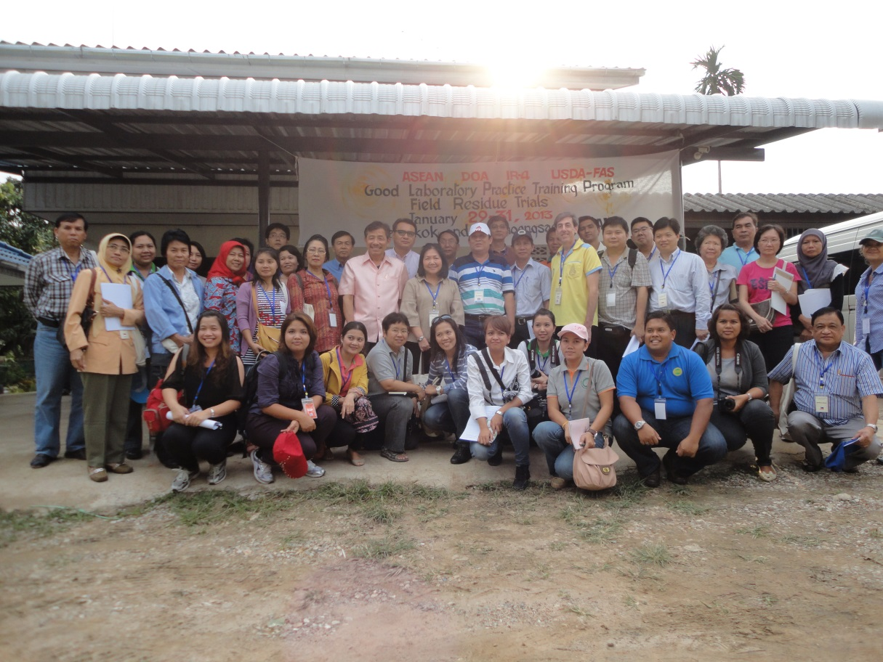
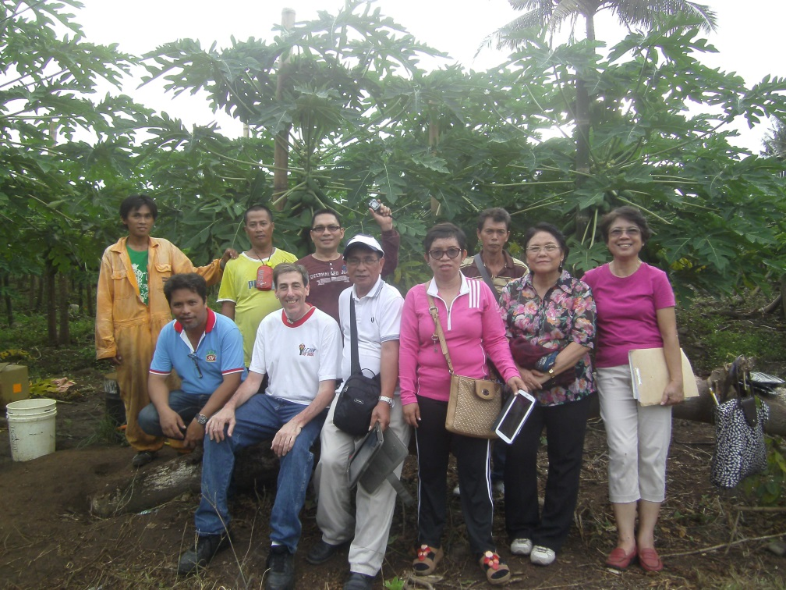
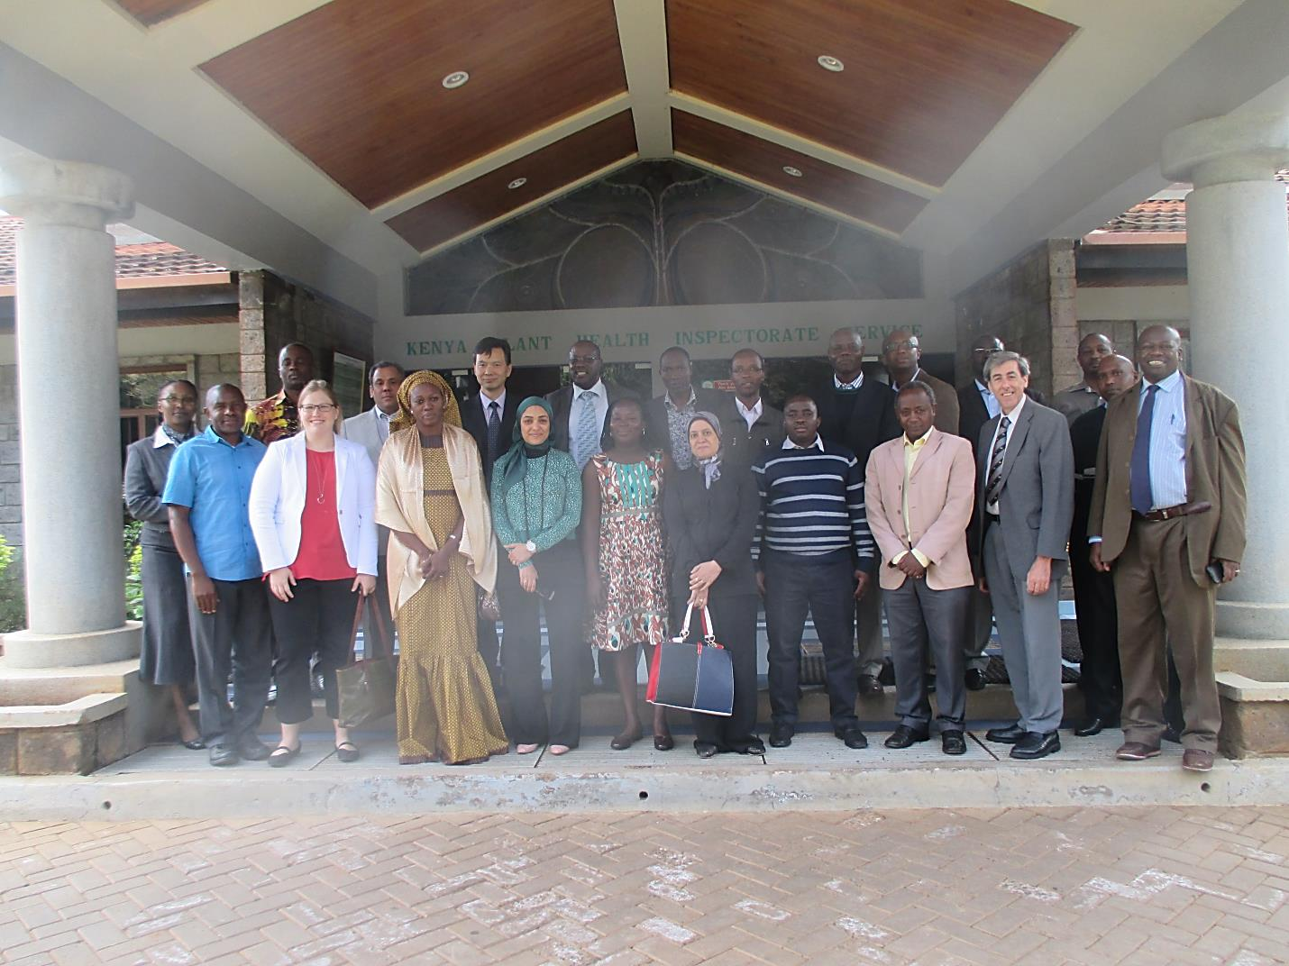
International Residue Studies – Capacity Building or Research >60 Countries, >>100 Scientists.

Slide 13
GMUS-1 Rome 2007 GMUS-2 Rome 2012 GMUS-3 Montreal 2017 GMUS-4 ???? 2022
Global Minor Use Summits

Slide 14
Success
Over 40,000 uses registered for specialty crops and minor uses since 1963
Majority are reduced/lower risk technology and registered in the last 15 years

Slide 15
Benefits
Growers
Legal access to safe & effective pest management technology……grow high quality crops
Food Processors & Food Retailers
Consistent supply of raw materials
Economy
IR-4 contributes $9.4 Billion to annual US GDP/supports >95,200 jobs
Public
Plentiful supply of specialty crops that contribute to a healthy diet & plants that enhance the environment.

Slide 16
Modern Minor Use Problem
Registrations are plentiful but ability to use approved pest management products can be limited:
Export issues
Efficacy data needs
Pest resistance
Use restrictions
Public acceptance

Slide 17
Thank You!

