Slide 1
The IR-4 Environmental Horticulture Program

Slide 2
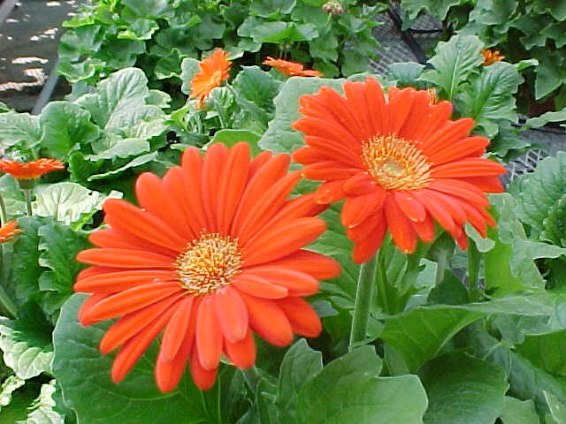
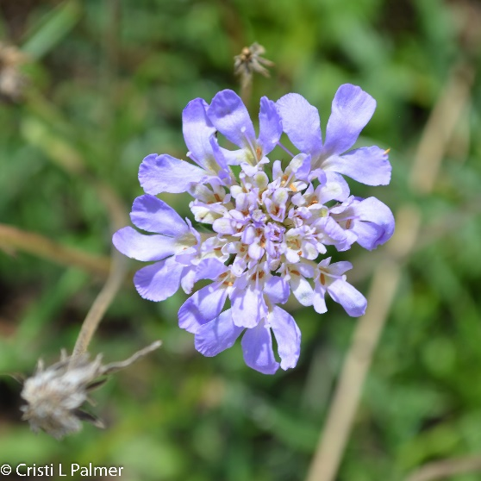
Environmental Horticulture Program
Overview
Registration Support
Invasive Species
Pollinator Protection
The IR-4 Environmental Horticulture Program fosters a diverse selection of healthy plants for bouquets, houseplants, landscapes and urban forests.
Healthy plants provide numerous physical and mental benefits:
Filter impurities out of air and water
Provide food and habitat for animals and people
Ameliorate urban heat islands
Reduce stress levels thereby improving productivity and conflict resolution
Enhance property value
Reduce neighborhood crime rates
Photos by Dr. Cristi Palmer

Slide 3
Environmental Horticulture Program
Overview
Registration Support
Invasive Species
Pollinator Protection
Registration Support
Helping growers get the tools they need to grow quality crops
Invasive Species
Coordinating cross-institutional teams to mitigate new exotic species causing economic or environmental harm
Pollinator Protection
Coordinating cross-institutional team to study attractiveness of environmental horticulture crops, systemic insecticide residue dynamics, economics/efficacy/ecotoxicology of alternatives, and consumer willingness to pay for quality pollinator attractive crops.

Slide 4
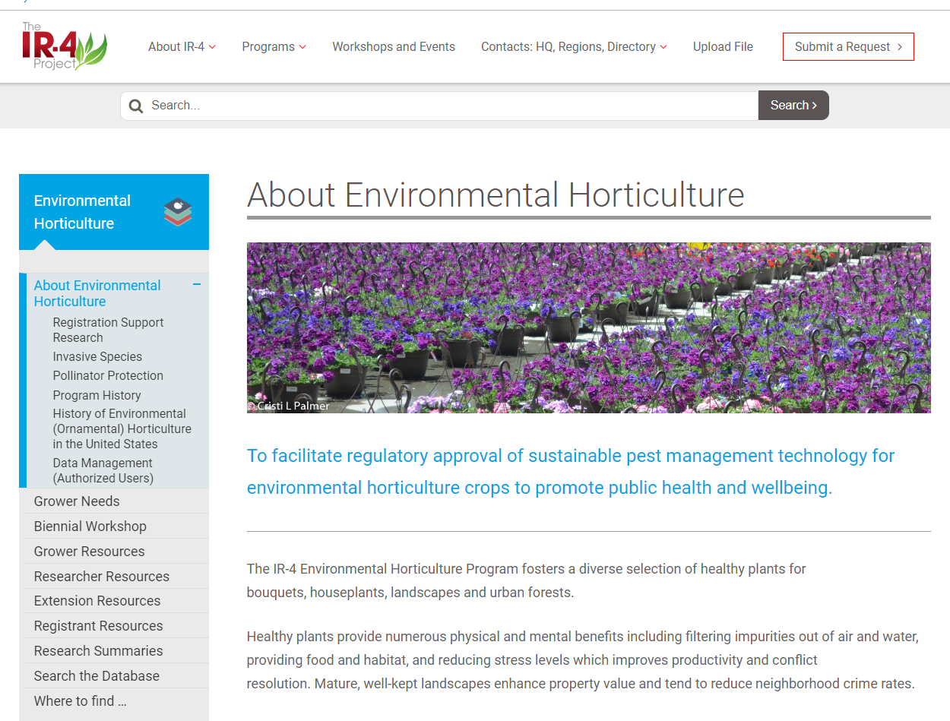
EnvironHort - Website
Overview
Registration Support
Invasive Species
Pollinator Protection
Overview of each program element
Organized by users:
Growers
Researchers
Extension Personnel
Registrants
Where to find … page will help locate resources
Research Summaries
Search the Database

Slide 5
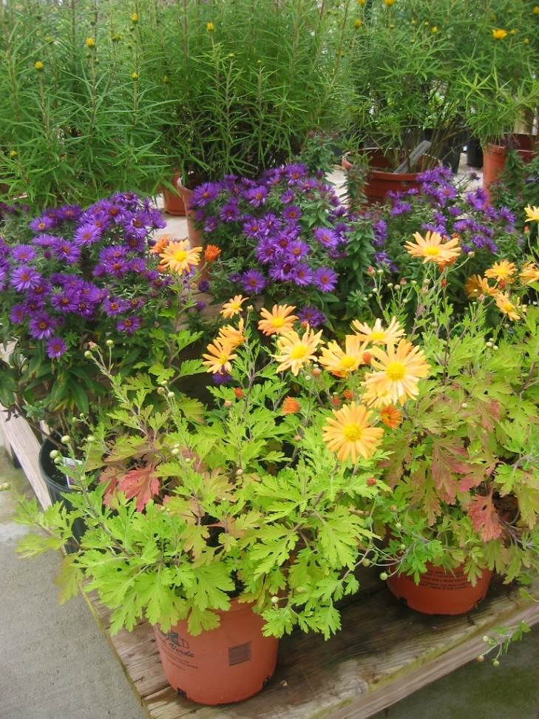
Environmental Horticulture Program
Overview
Registration Support
Invasive Species
Pollinator Protection
IR-4 coordinates national and regional research projects to develop efficacy and crop safety data so that new biological and chemical active ingredients can be registered and current products expanded for new uses.
Outcomes
Over 44,000 crop uses have been registered.
Pathogen, pest, and weed management tools are readily available to greenhouse and nursery growers.
Growers and consumers benefit by having more tools for Integrated Pest Management systems and resistance management strategies
Photo by Dr. Cristi Palmer

Slide 6
EnvironHort - Process
Overview
Registration Support
Invasive Species
Pollinator Protection
Identify grower needs through surveys and project requests
Prioritize projects at biennial workshop
Conduct research with key entomologists, horticulturists, plant pathologists and weed scientists throughout the US
Communicate results by compiling trial data and posting summaries
Track impacts of these research activities
Network with growers, researchers, registrants and regulatory officials

Slide 7
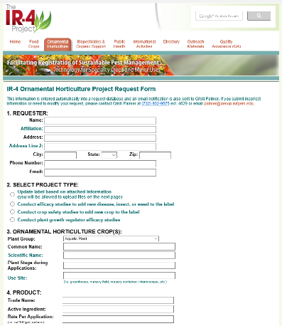
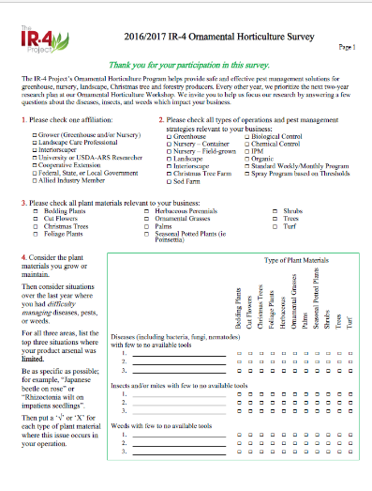
EnvironHort – Project Prioritization
Overview
Registration Support
Invasive Species
Pollinator Protection
Researcher & Registrant Input
Stakeholder Input
balanced with
Project Criteria
Availability & effectiveness of current options
Damage potential of target
Performance and crop safety of proposed products
Compatibility with IPM, resistance management programs
Economics
Geographic distribution
Registrant interest in labeling product(s)
Other
Online Project Request Form
Paper or Online Biennial Survey

Slide 8
EnvironHort – Research Cycle
Overview
Registration Support
Invasive Species
Pollinator Protection
January
Establish Research Trials
Annual National Research Planning Meeting
Receive & Summarize Trial Data
October
Biennual Workshop
April
Identify Grower Needs
Project Request Form
Grower/Extension Survey
July

Slide 9
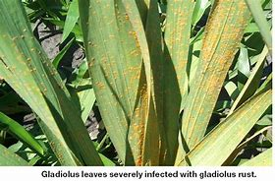
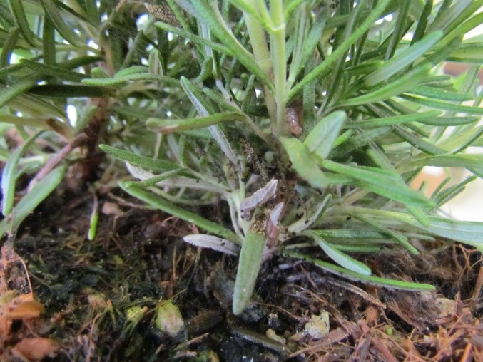
Environmental Horticulture Program
Overview
Registration Support
Invasive Species
Pollinator Protection
IR-4 has coordinated research projects studying mitigation strategies and developing basic knowledge for several invasive species – boxwood blight, chrysanthemum white rust, European pepper moth, gladiolus rust, impatiens downy mildew.
Outcomes
Improved management strategies
Better understanding of environmental parameters for pathogen infection and pest development
Serological and genetic diagnostic tools
Increased knowledge of basic biological and genetic characteristics of these pathogens and pests
European Pepper Moth on Rosemary, Dr. Jim Bethke

Slide 10
Environmental Horticulture Program
Overview
Registration Support
Invasive Species
Pollinator Protection
IR-4 coordinates national and regional research projects to develop efficacy and crop safety data so that new biological and chemical active ingredients can be registered and current products expanded for new uses.
Identify grower needs through surveys and project requests
Prioritize projects at biennial workshop
Conduct research with key entomologists, horticulturists, plant pathologists and weed scientists throughout the US
Communicate results by compiling trial data and posting summaries
Track impacts of these research activities
Network with growers, researchers, registrants and regulatory officials

Slide 11
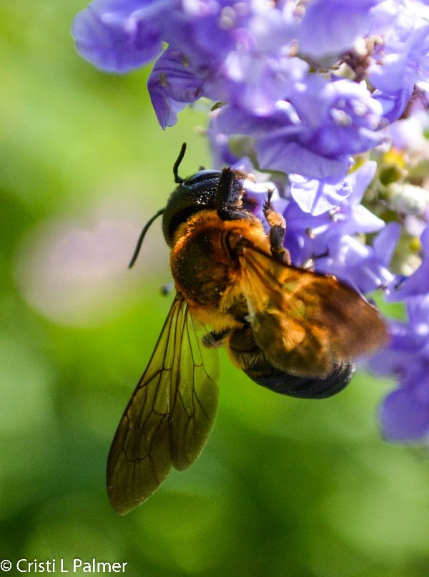
Environmental Horticulture Program
Overview
Registration Support
Invasive Species
Pollinator Protection
IR-4 is coordinating a cross-institutional team to study how to produce quality environmental horticulture crops while protecting pollinators.
Outcomes/In Progress
Knowledge of attractiveness level of top produced annuals, herbaceous perennials and woodies
Residue dynamics of systemic insecticides in environmental horticulture crops
Efficacy, Economic & Ecotoxicology comparisons of alternatives
Consumer perceptions and willingness to pay for plant attributes
Revised best management practices

Slide 12
Thank You!

